Slide 1
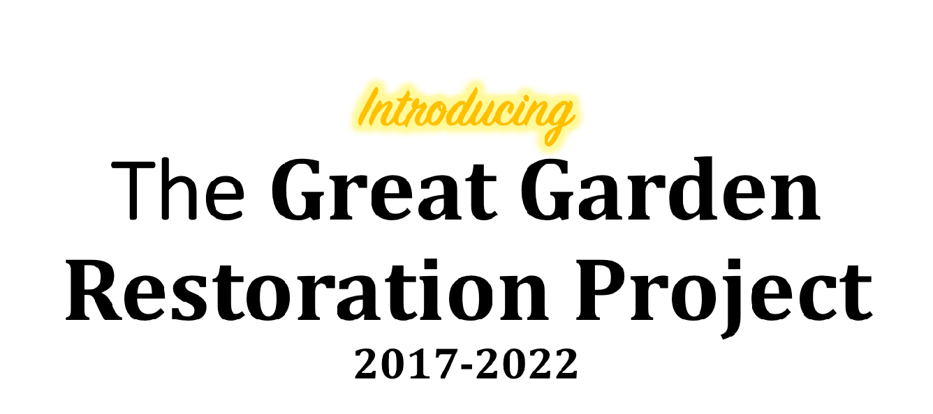
at the AMERICAN ROSE CENTER
National Home and Headquarters of the American Rose Society
Shreveport, Louisiana

Slide 2
and a theme:
The new gardens will tell . . .
‘The HISTORY of the ROSE IN AMERICA’
The Great Garden Restoration Project
brought about the renaming of the gardens, now known as . . .
‘America’s Rose Garden’

Slide 3
The American Rose Center showcases a number of valuable, well-maintained, unemcumbered assets.
We begin the Great Garden Restoration with an important history behind us. We have a lot to be proud of in the existing structures. Take a look . . . . . .

Slide 4
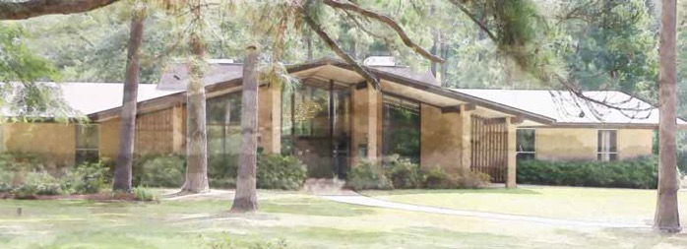
The THIGPEN-HEROLD ADMINISTRATION BUILDING was built soon after the property was received as a gift in 1970. The gardens were designed in 1972, and installed and occupied as ARS National Headquarters in 1974.
In 2022, at the completion of our restoration plan, the
American Rose Center will celebrate its 50th anniversary.

Slide 5
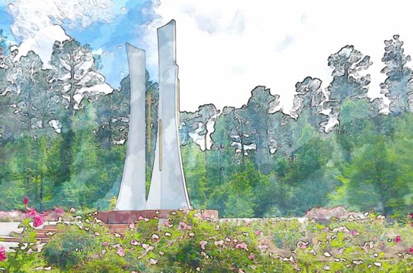
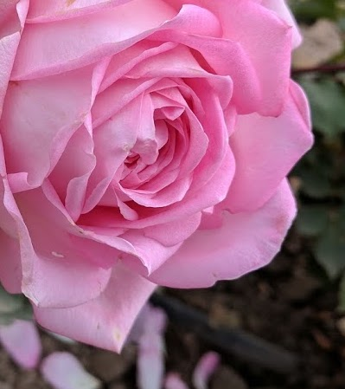
WINDSOUNDS c. 1970s, is the garden’s ”signature”. It is the site of the new ARC International Rose Trials, to begin in 2019.

Slide 6
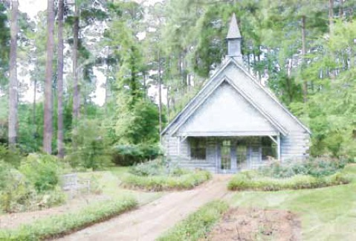
HARDTNER CHAPEL c. 1970s, site of weddings & other events.
Several nearby rose gardens provide blooms for brides and their wedding parties along paths leading to the log Chapel.

Slide 7
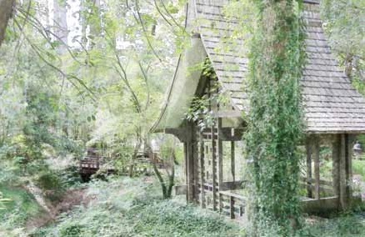
ASIAN TEA HOUSE & GARDENS c. 1970s.
A favorite site, the gardens are being expanded in
2018-2019 to provide additional interest.

Slide 8
KLIMA EDUCATION & VISITOR CENTER c. 2005, site of horticulture-educational programs, events and receptions. Hering Gift Shop, Schorr Library, Whitaker Hall, Wellan Terrace, meeting rooms, bride’s suite, catering kitchen – all make Klima Rose Hall valuable and useful.

Slide 9
WATKINS REFLECTION POOL c. 2007
The reflection pool has been a magnificent addition, for the view from Wellan Terrace at Klima Rose Hall, and looking back toward the building. Allees of trees will be planted on both sides of the pool in spring 2019, providing additional grand and beautiful elements to the garden. The pool sets the tone for the overall gardens, one of serenity.

Slide 10
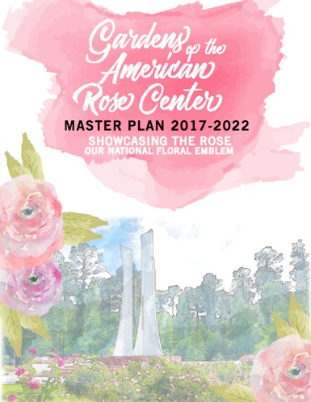
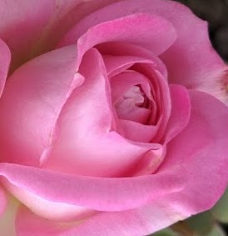
THE MASTER PLAN was created in 2017 - it is a five-year plan to totally restore the gardens at the American Rose Center . . . to re-create a world class garden we can be proud of; where our garden takes its rightful place among the great rose gardens of the world.
The Master Plan tells the history of the gardens, and tells of our future through the goals we have set.

Slide 11
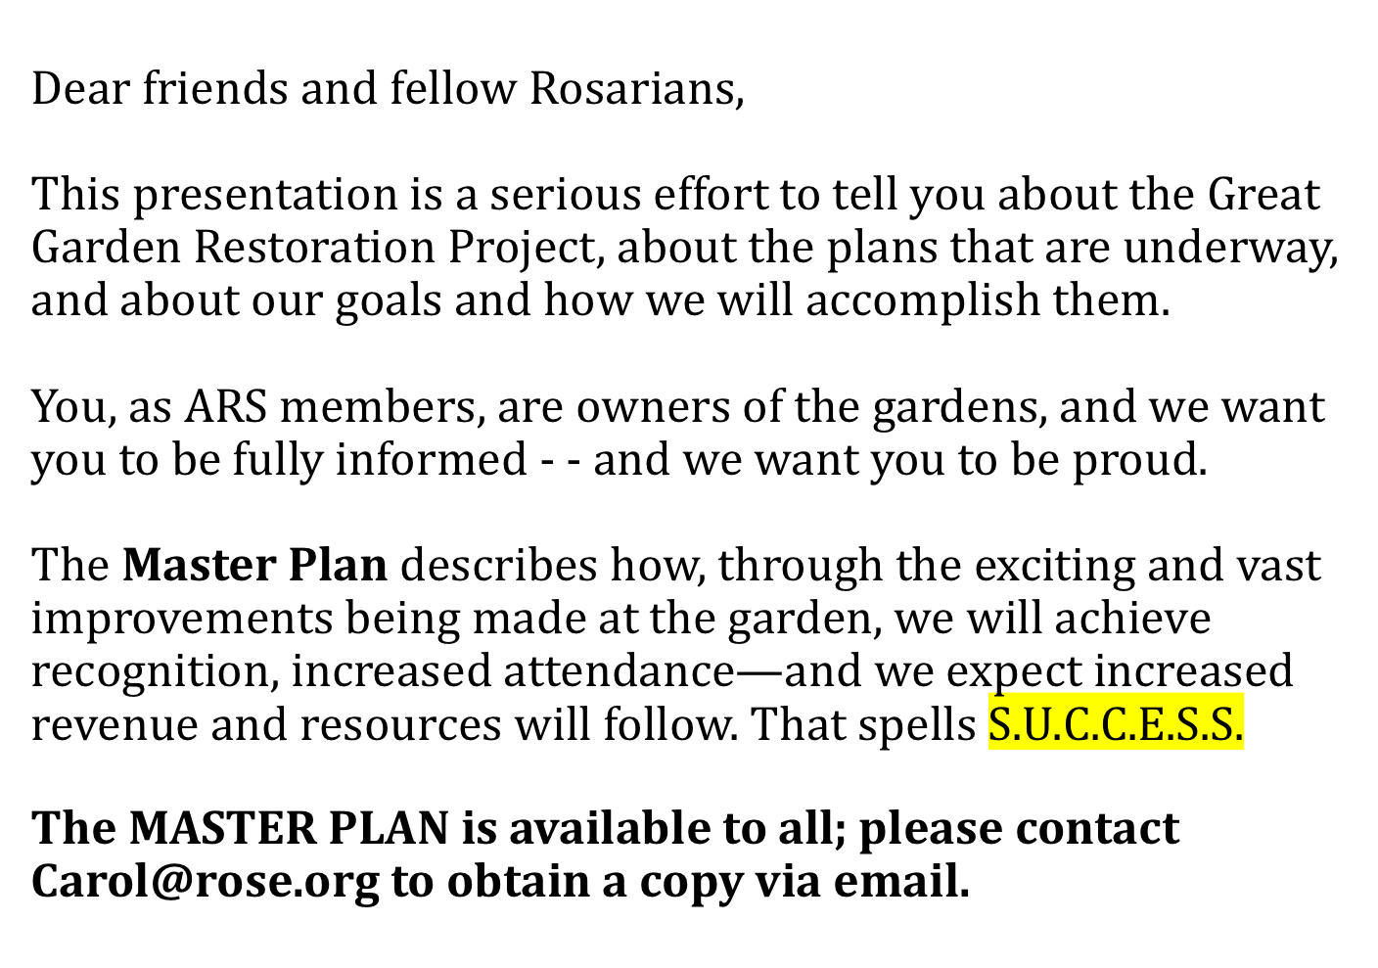

Slide 12
Our goals are AMBITIOUS! By the end of the five-year restoration period, we plan to achieve the following:
Gain Historic Garden status with National Parks Service.
Be recognized as a Botanic Garden.
Host our first annual International Rose Trials event.
Organize an active ‘Friends of the Gardens’ organization.
Complete Children’s Garden, and host activities that teach
children about the beauty of nature, gardens and growing
roses.
Provide activities that draw people to the gardens for rest,
for pleasure and for educational programming on all aspects
of outdoor life, but especially the pleasure of growing roses.
INCREASED REVENUE TO BE ABLE TO SUSTAIN THE GARDEN
NOW AND IN THE FUTURE.

Slide 13
6 PRIORITIES FOR GARDEN RESTORATION
FIRST PRIORITY - PINE TREES!
Pines that were small when we planted the garden in 1970s grew to amazing heights, and spread huge roots. The result – TALL PINES sapped up all the sunshine that the roses needed for the garden and the ROOTS sapped up all the water and nutrients that the roses needed.
SOLUTION – REMOVE THE PINE TREES!
And we did that – Last summer, 140 magnificent pines were removed from two areas of the gardens: the area around the Gulf District Garden of David Austin Roses, and the area that will soon become the featured rose garden at the Rose Center.
The bids we received were in the range of $80,000 - $90,000! We found a timberman who removed the trees for the lumber he would recover – only because he was cutting trees in the nearby property. Result – no cost to the ARC.
DONE

Slide 14
6 PRIORITIES FOR THE GARDENS
SECOND PRIORITY – DEER!
DEER multiplied and dined on fresh new growth on roses, stunting them in each new growing season.
SOLUTION – INSTALL DEER FENCE!
Thanks to a $10,000 donation from the Collin County Rose Society of Dallas, plus a $10,000 donation from Jim and Anne Hering, plus additional donations by the Gulf District and some of its members, we have purchased deer fencing and it is installed around the entire garden property.
NOTE: The Collin County Rose Society has challenged other societies across the ARS to participate and support the restoration project, so important to the prestige and success of the ARS.
DONE

Slide 15
“The Collin County Rose Society is a small rose society in suburban Dallas. We have about 30 member families with an annual operating budget of less than $1,000 with a treasury of $16,000. We took an honest look at the amount of money we had relative to our needs. . . . The Board decided it was irresponsible for us to just sit on such a large amount of money.
We decided to put some of that money to work and voted to donate $10,000 to the Great Garden Restoration Project. It is great feeling to know that our money will be used to help build a wonderful rose garden for the American Rose Society.
“Collin County Rose Society is issuing a challenge to all the other rose societies around the country to join us in supporting the Great Garden Restoration Project.
“Many Rose Societies are sitting on monies in their treasuries far in excess of the amount actually needed to sustain and operate their local society. Unless these societies actually have some specific targeted use planned for those excess funds, I suggest that they could be put to much better use NOW to help the American Rose Center build a truly Great Rose Garden at the ARS National Headquarters!”
Claude Graves for Collin County Rose Society
COLLIN COUNTY ROSE SOCIETY
CHALLENGE

Slide 16
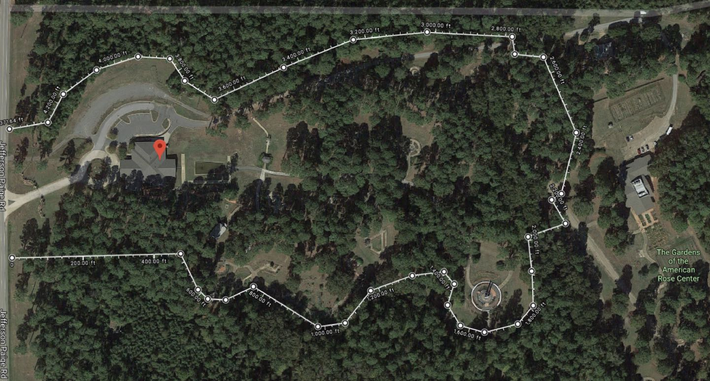
This Google image shows the majority of our 118 acre property before removal of the 140 pine trees. Here we were planning for the DEER FENCE around the area of the gardens to be maintained, and we expect them to be deer-free!
N
Adm Bldg
Klima Bldg
NEW CORE GARDEN
Windsounds

Slide 17
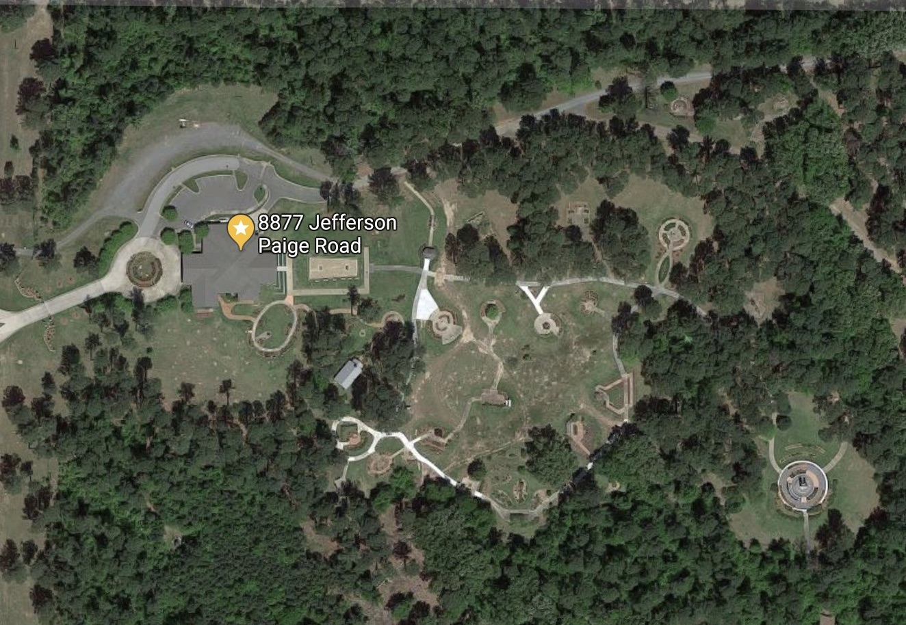
This new Google image shows where 140 trees were removed –
South of the Klima Bldg and in the area that is the Core Garden.
The bright white marks in this image are the new concrete paths and walkways
that have been replaced in the Core Garden, thanks to a grant from Louisiana Tourism Trails program.

Slide 18
6 PRIORITIES FOR THE GARDENS
THIRD PRIORITY – CONSOLIDATION!
Seventy-two gardens scattered over a very large area were just too much to take care of. Forty-five year-old gardens with no underlying support had grown shabby over the years; maintenance was difficult and expensive.
SOLUTION -
The gardens are being consolidated into a CORE GARDEN, where we can provide a better garden visitor experience – hopefully the WOW factor!
The great rose company, JACKSON & PERKINS contributed the garden design
by Paul Zimmerman and Richard Beales. Construction drawings have been completed by Ward Bryant of Makers Design. Installation of the FIRST CIRCLE should begin in 2019, once the fund-raising drive for that segment is complete.
DONE

Slide 19
CORE GARDEN IDENTIFIED
1. Close to Klima Visitor Center.
2. Surrounded by existing walk.
3. Right size - 3.5 to 4 acres.

Slide 20
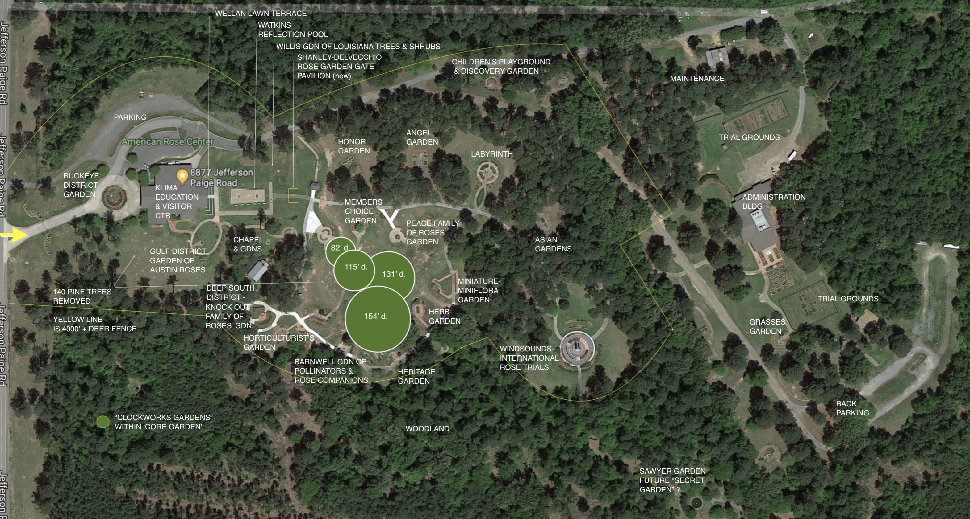
GET TO KNOW AMERICA’S ROSE GARDEN
The green circles represent the four circles of the new “clockworks” gardens, located within the “core garden” that is surrounded by the major walkway.

Slide 21
6 PRIORITIES FOR THE GARDENS
FOURTH PRIORITY – IRRIGATION!
INADEQUATE is the word. Water flooding the beds in some places. Water shooting up like a geyser in some places. Water spilling into the street and walkways in some places. And water not getting to some plants at all.
SOLUTION -
The American Rose Center Committee approved
sub-surface drip irrigation system which will be
installed in existing gardens and
will soon be installed in all the new
gardens throughout the ARC.
SURVEY IS COMPLETE; SOME FUNDS RAISED

Slide 22
6 PRIORITIES FOR THE GARDENS
FIFTH PRIORITY – REBUILD SOIL!
Through the years, the soil in our rose beds deteriorated to the point that roses were not thriving, and roots were diminished.
SOLUTION – SOIL ADDITIVES, ORGANICS,
MULCH
First, we tested the soil, and are working to make recommended amendments to pH levels and to bring other elements to the recommended levels.
As new roses are introduced to new beds, we are adding mulch and organics, mixing into the soil to replenish the nutrients. In new beds, we will begin with these additions, with deep tilling of the area to insure roses get off to a great start.
SOILS TESTED; RESTORING SOIL AS BEDS ARE CREATED

Slide 23
ALWAYS TOP PRIORITY
6 PRIORITIES FOR THE GARDENS
SIXTH PRIORITY - MAINTAIN THE GARDENS!
We haven’t always done so well with the maintaining of the gardens, but it is our goal to improve in our ability to grow superior roses, and to maintain gardens that are of excellent quality and have a good appearance at all times.
SOLUTION – OVERSIGHT, VOLUNTEERS
Finding the right kind of garden staff is important. A new Garden Director, Don Morgan has been hired. Frank Hover of the Shreveport Rose Society has assumed the role of liaison between staff and the American Rose Center Committee in overseeing the work schedules and the work. We expect that as the gardens are developed, revenue will increase, and garden staff can be increased. We also hope to develop a base of support among a volunteer corps, that will take some of the responsibility for caring for the gardens.

Slide 24
Transforming the Garden
Experience . . . by Design
1. REDUCTION IN NUMBER OF GARDENS
From 70 Gardens = less cost, more impact, easier to maintain.
2. REDESIGN GARDEN TO PROVIDE IMPACT – the WOW factor!
The great rose nursery, JACKSON & PERKINS has financed the garden design of the gardens. Designers are Paul Zimmerman and Richard Beales.
3. PLAN FOR YEAR-ROUND APPEAL
Year-round appeal will be accomplished by the addition of companion plants, shrubs, small trees, herbs, plants of winter interest, and of interest to broad spectrum of garden visitors.

Slide 25
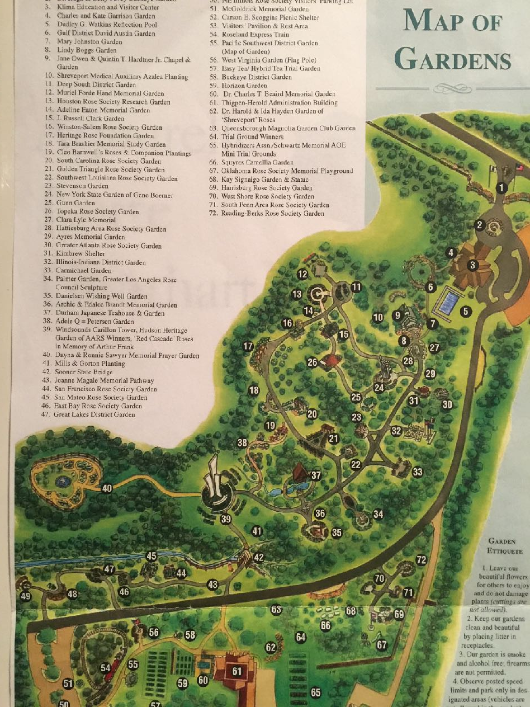
THE OLD MAP . . .
72 Gardens & Garden Elements
N

Slide 26
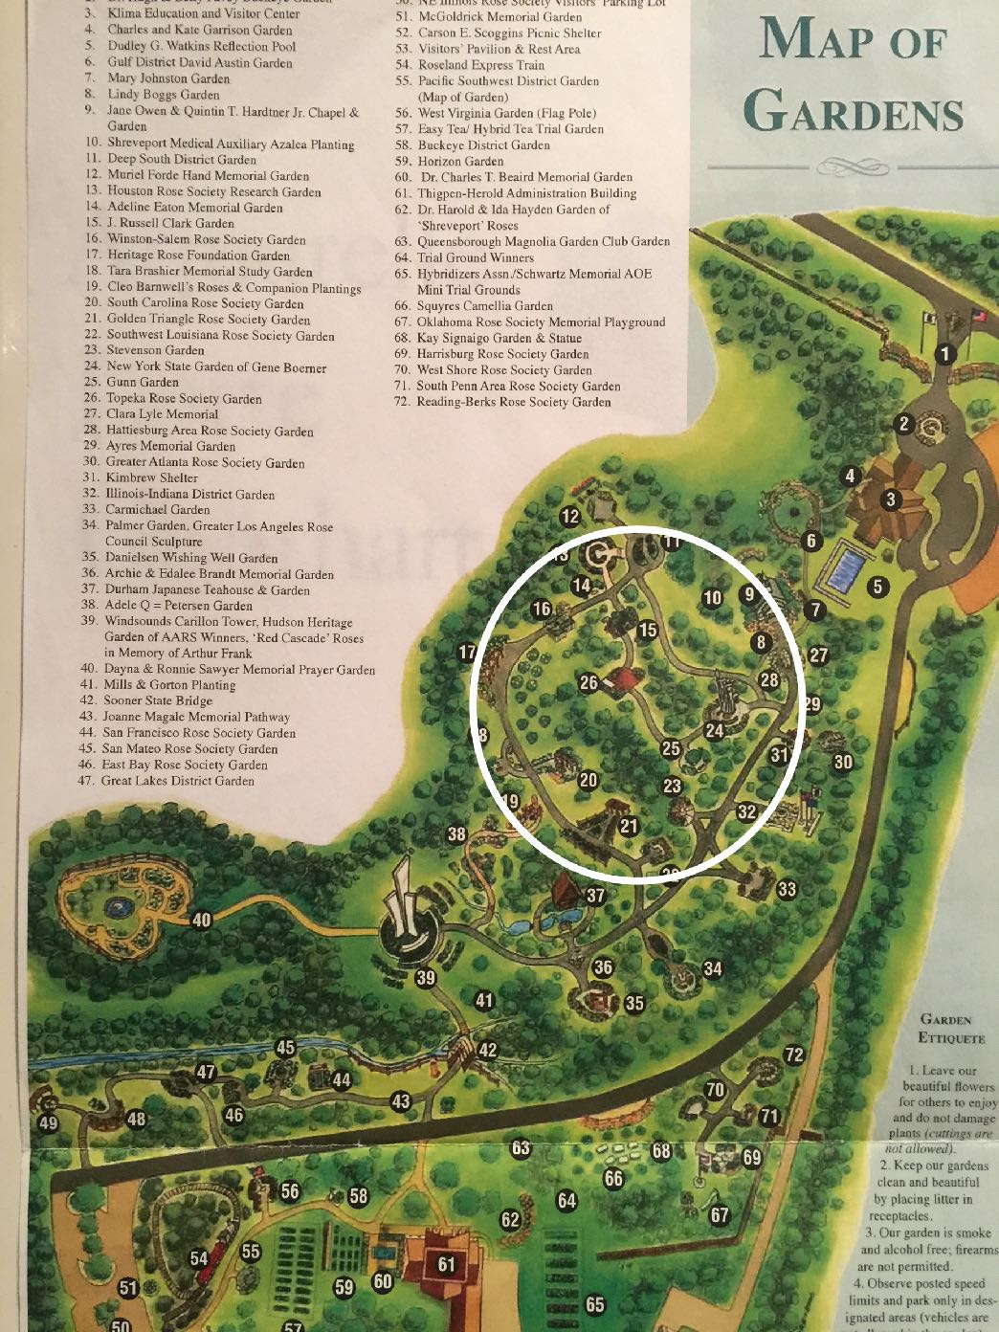
THE NEW “CORE” GARDEN location -
Looking for that WOW factor!

Slide 27
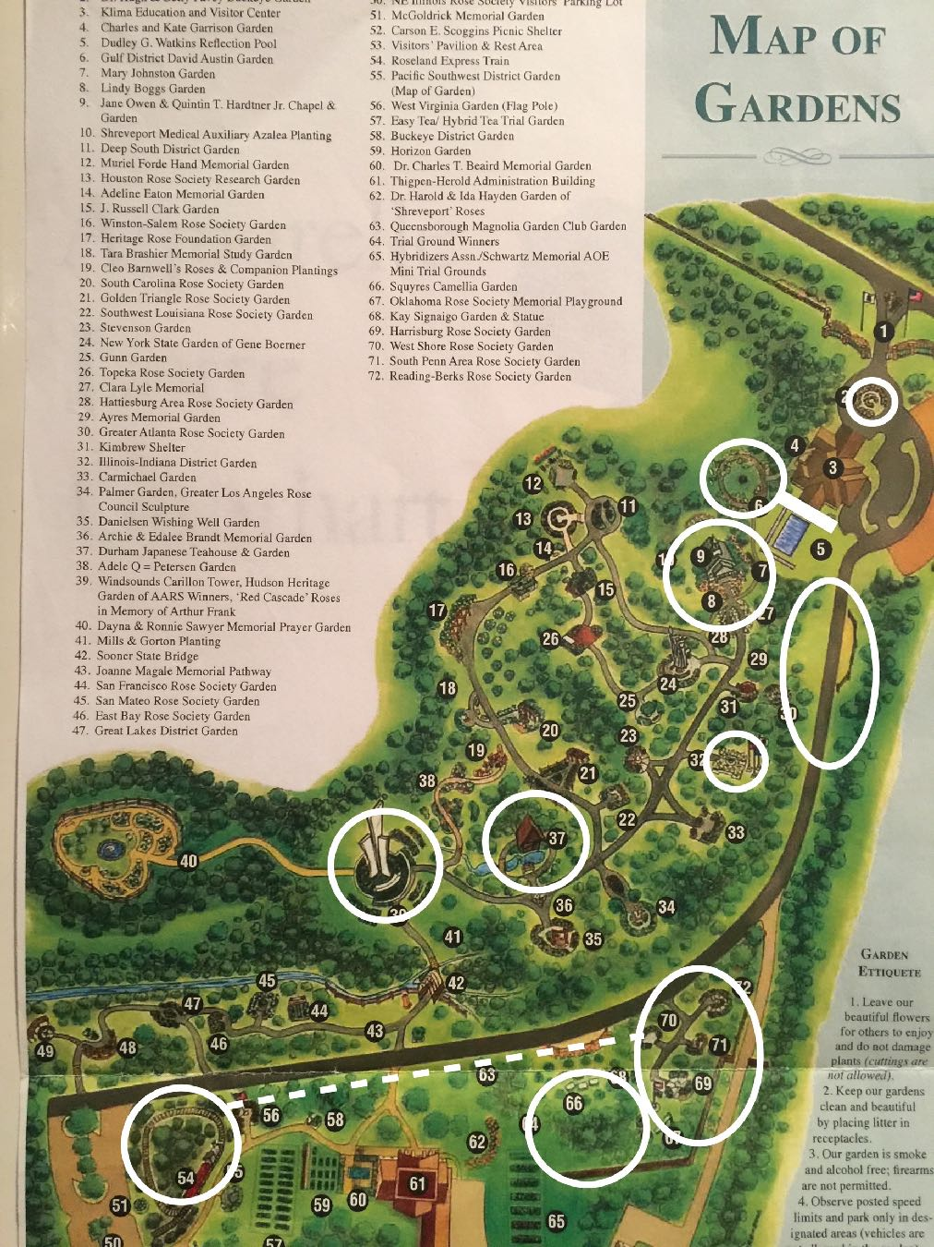
TO BE RETAINED OUTSIDE THE “CORE” GARDEN
ENTRANCE GARDEN (1)
BUCKEYE GARDEN (2)
AUSTIN GARDEN (6)
WELLAN LAWN TERRACE (3)
CHAPEL and
WEDDING RING GARDEN (37)
GDN OF LOUISIANA
TREES & SHRUBS (30)
ASIAN GARDEN (35, 36, 37)
WINDSOUNDS (39)
CAMELLIA GARDEN (66)
CHILDREN’S GARDEN &
PLAYGROUND (69, 70, 71)
TRAIN & FUTURE TRACK (54)
NEW:
HONOR GARDEN (32)
ANGEL GARDEN (33)
LABYRINTH GARDEN (34)
SHANLEY-DELVECCHIO ROSE
GARDEN GATE PAVILION

Slide 28
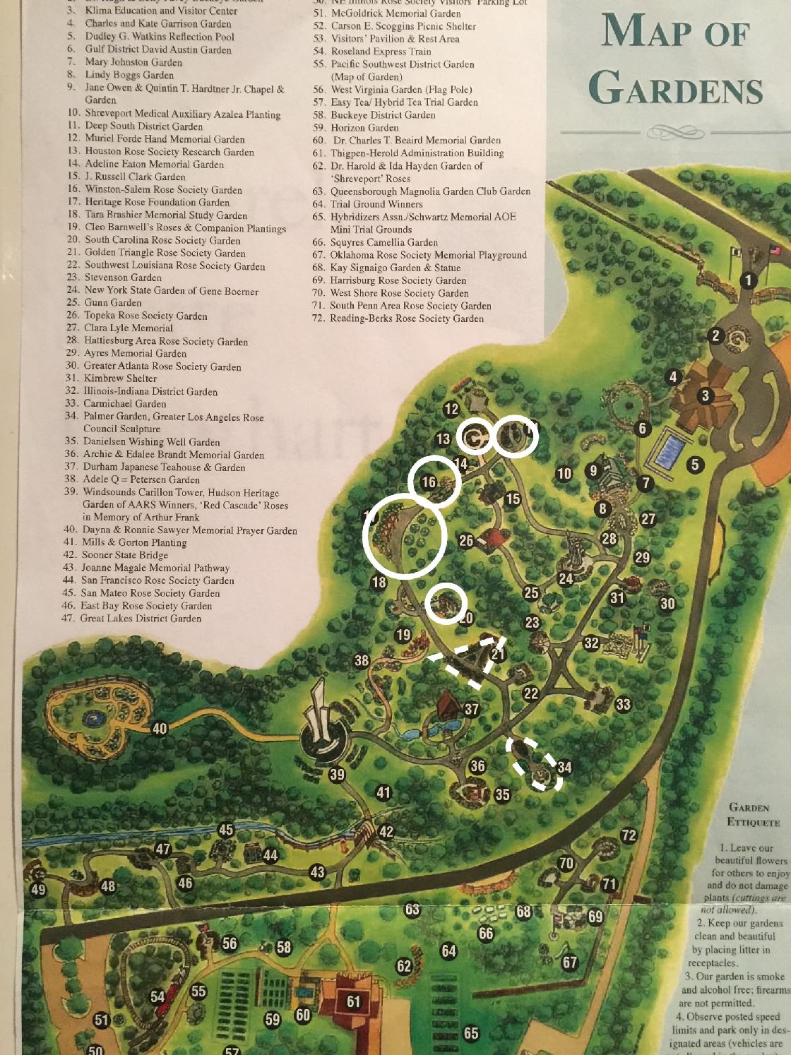
TO BE RETAINED . . .
INSIDE THE “CORE” GARDEN
GRIFFITH BUCK VARIETIES
RADLER VARIETIES
POLLINATOR GARDEN
HERITAGE ROSES GARDEN
HERB SOCIETY GARDEN
MINIATURE/MINIFLORA ROSE GARDEN

Slide 29
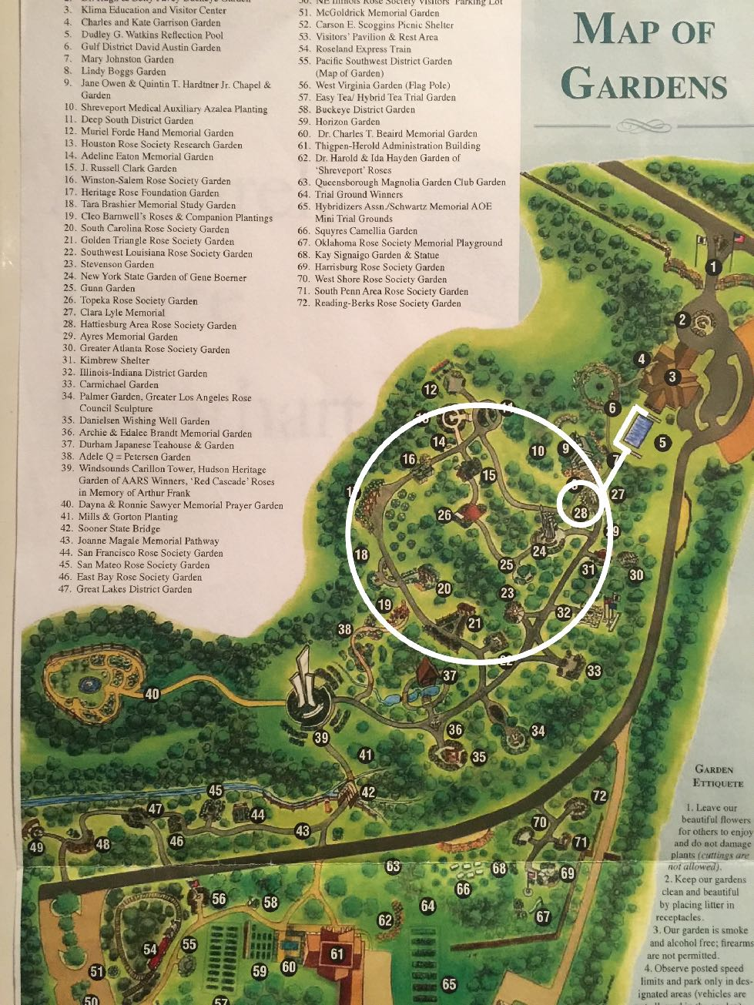
“CORE” GARDEN
THEME:
“The
History of the Rose in America”
Beginning with the new J. HORACE MCFARLAND PLAZA
J. Horace McFarland Plaza
Is a new feature in the new
Garden. It celebrates the
‘Father of the American Rose
Society.” McFarland Plaza will be planted with the new
‘McFarland’ rose
donated to us by
Meilland-Star
Roses!

Slide 30
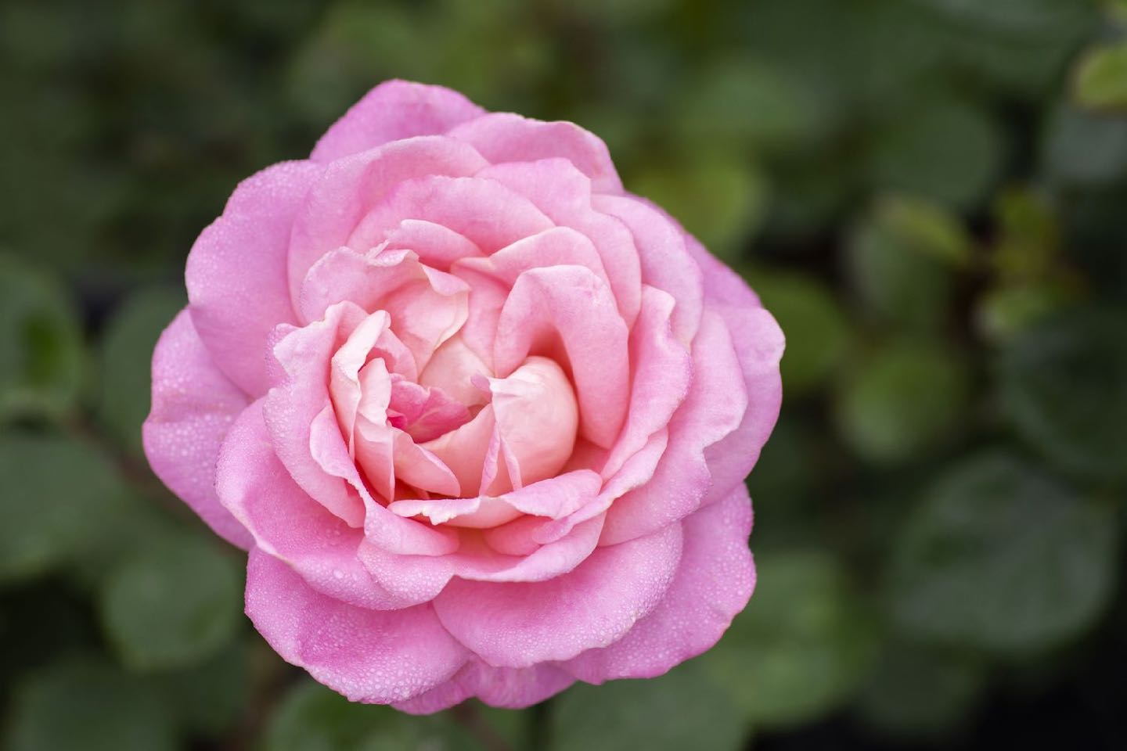
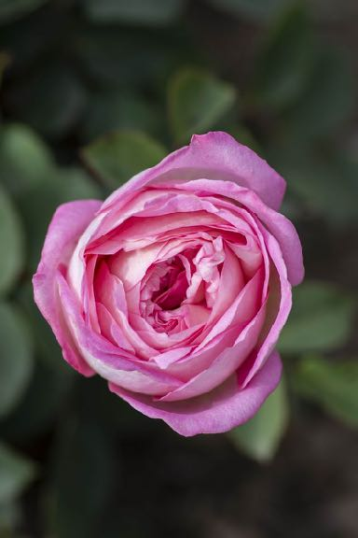
– ‘McFarland’ –

Slide 31
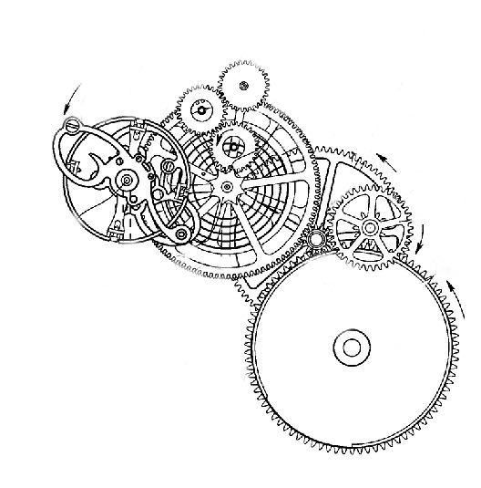
Here it is—the inspiration for the Garden Design . . . . telling
‘The History of the Rose in America’
. . . . . the rose in TIME.
Our new gardens are inspired by the gears of a vintage timepiece.

Slide 32
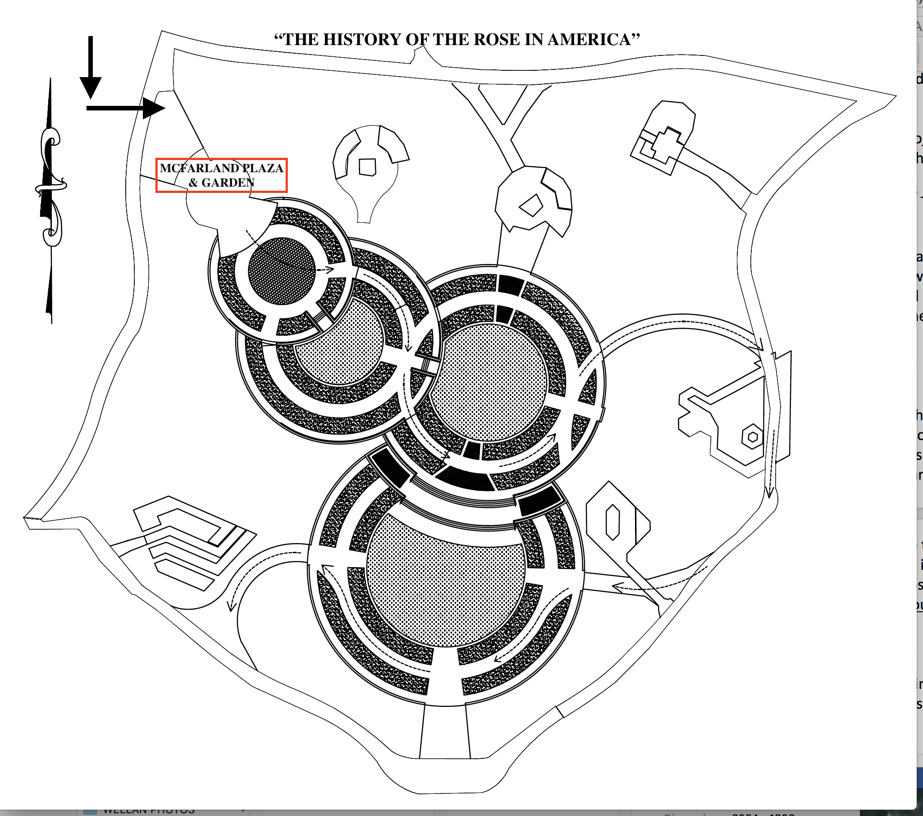
The History of the Rose in America will be told through the ‘clockworks’ that make up the new garden design – a series of circular gardens, as gears in a vintage pocket watch, representing ‘time’ in a graphic way. The garden tour will be a tour of Rose history, going back in time from the present day.
J. Horace McFarland Plaza
1st Circle-Exhibition Hybrid Teas
2nd Circle-Modern Roses incl.
HT, GR, FL, Min, LCl.
3rd Circle-Shrubs
4th Circle-Old Garden Roses
Lower garden – Species Roses

Slide 33
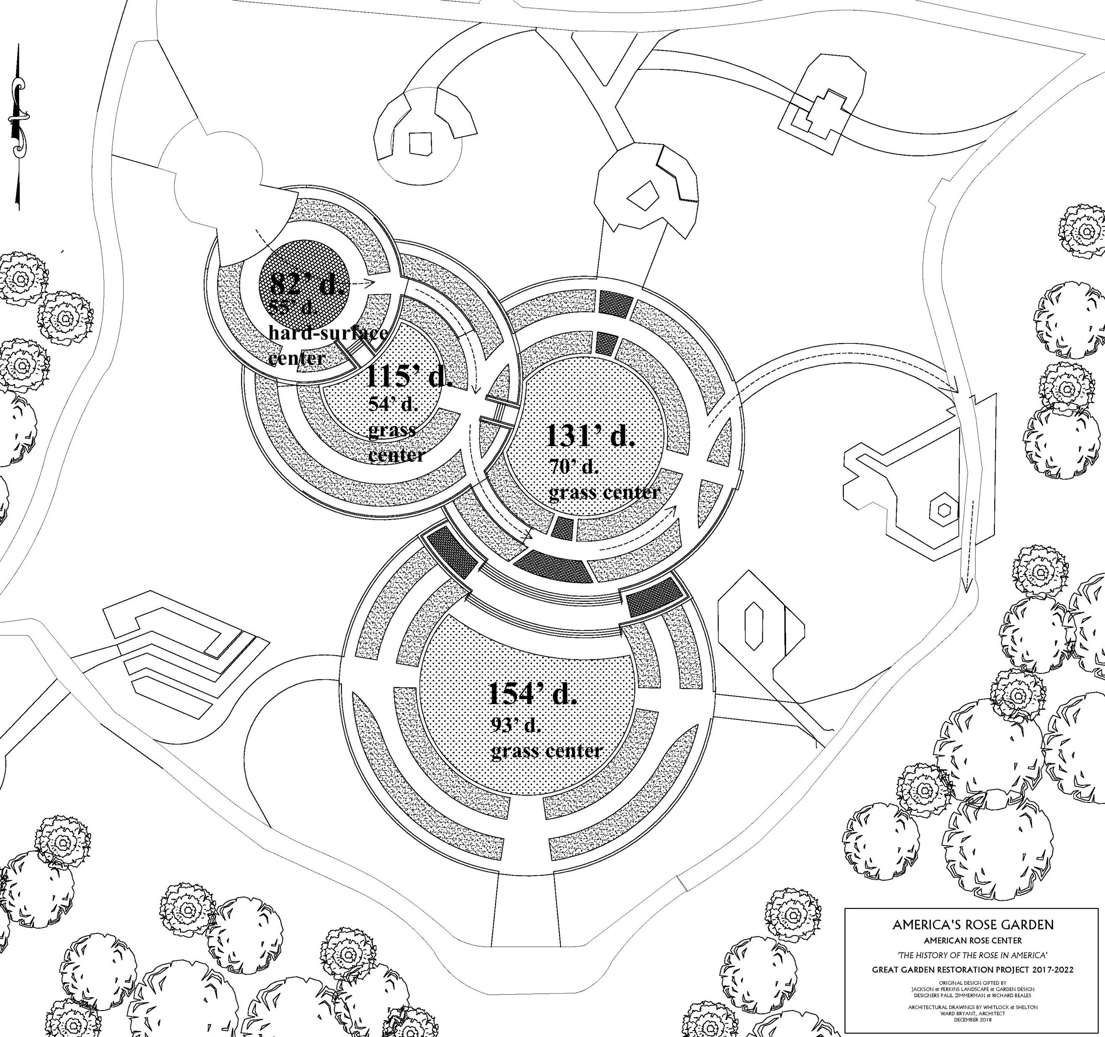

Slide 34
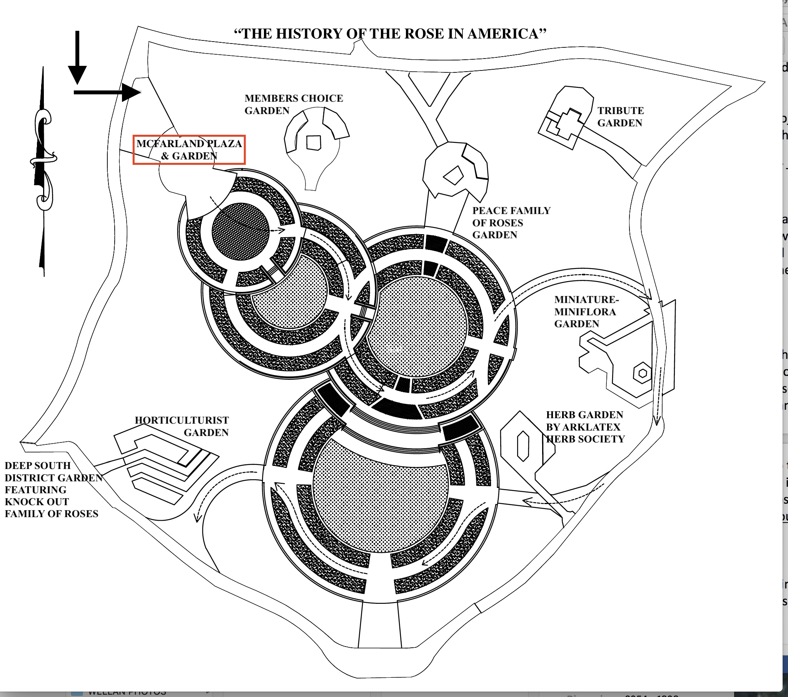
The History of the Rose in America, the rose in Time will include these and other stories:
ARS Members’ Choice
This small garden will present roses of all classes chosen by ARS members as successful representations of new roses.
Peace Family of Roses
This small garden will present one of the great rose stories of all time – that of the Peace Rose.
Mini-Miniflora Roses, AOE Collections of miniature and miniflora roses by the breeders who created them. Also the garden for AOE Trials.
Herb Garden by ARK-LA-TEX
Herb Society.
Horticulturist Garden honoring Dr. Allen Owings.
Knock Out Family of Roses
by ARS Deep South District.

Slide 35
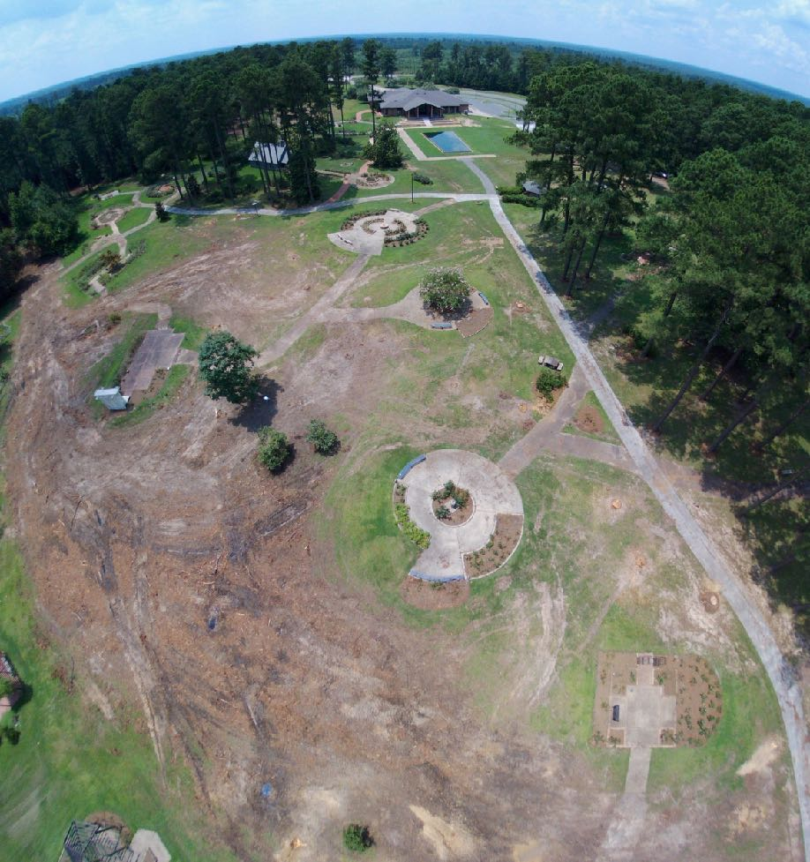
Looking back:
CORE GARDEN
After cutting of the trees, the ”core garden” is a large bald spot - a ‘blank canvas.’
THIS IS A WINTER PHOTO. Rye grass was seeded in the area to provide a ground cover.
The design’s ‘watch parts’ will connect to the three existing circular gardens along the main walk.

Slide 36
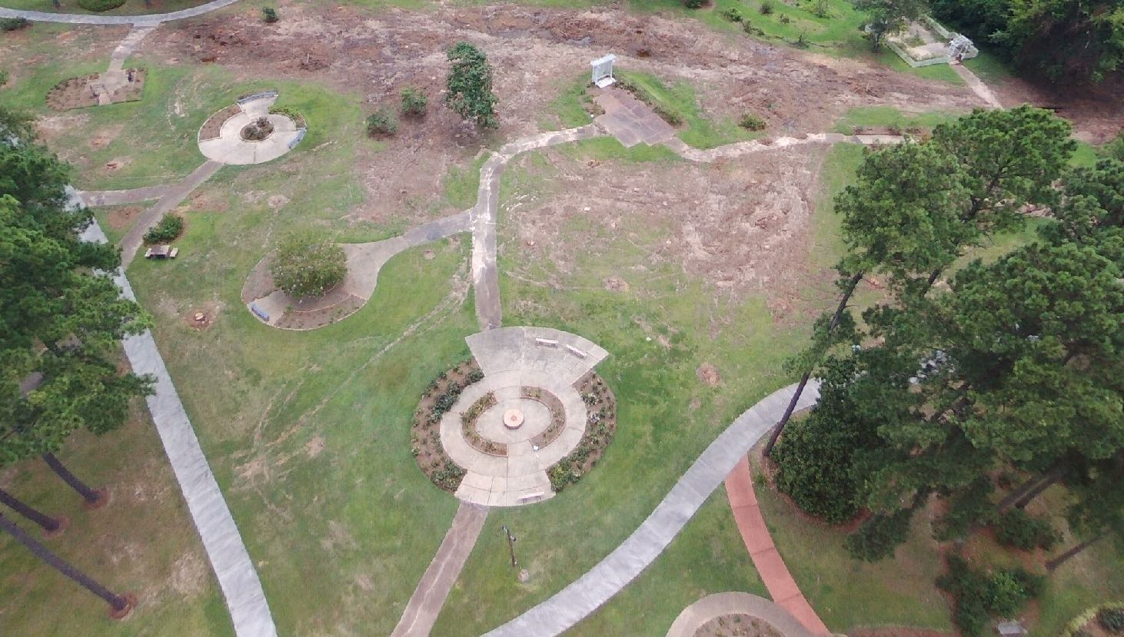
‘Core Garden’ where the garden tour will begin- at J. Horace McFarland Plaza.
J. HORACE MCFARLAND PLAZA

Slide 37
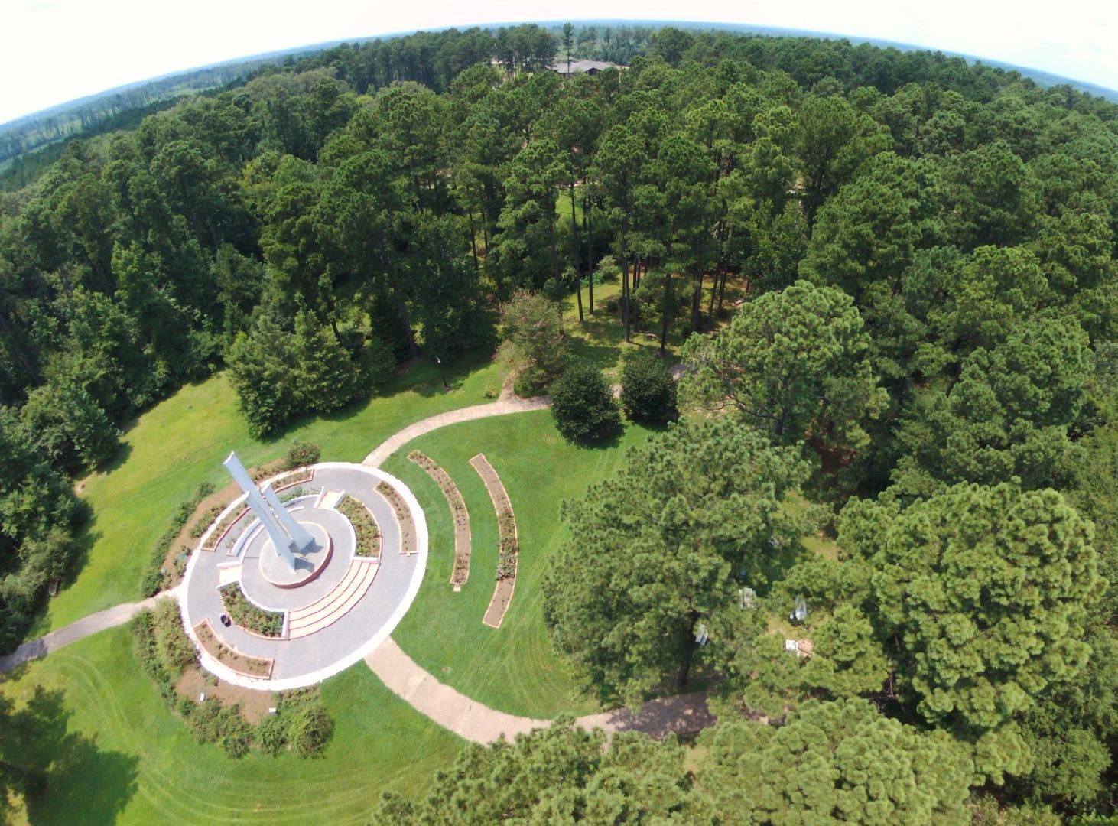
WINDSOUNDS CARILON TOWER –- site of INTERNATIONAL ROSE TRIALS
Plenty of room for expansion.
Note Klima Rose Hall in distant center.
KLIMA ROSE HALL
Beautiful view of ‘Windsounds’, 30’ sculpture that has been the “signature of the gardens” since it was installed in the 1970s. It will be the site of the new
ARC International Rose Trials

Slide 38
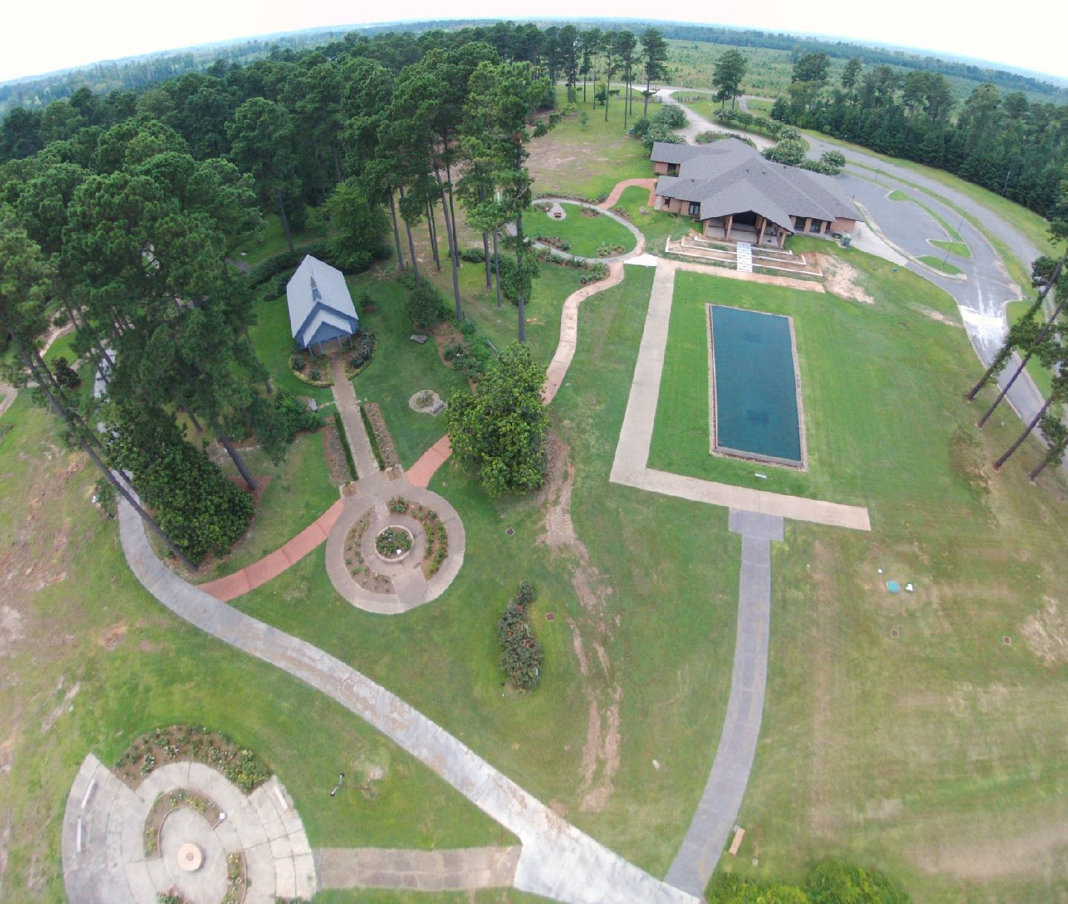
Klima Gardens and Chapel Gardens; great hardscape; ready for important landscaping upgrades. New Shanley-Delvecchio Rose Garden Gate Pavilion is now in place in front of the pool.

Slide 39
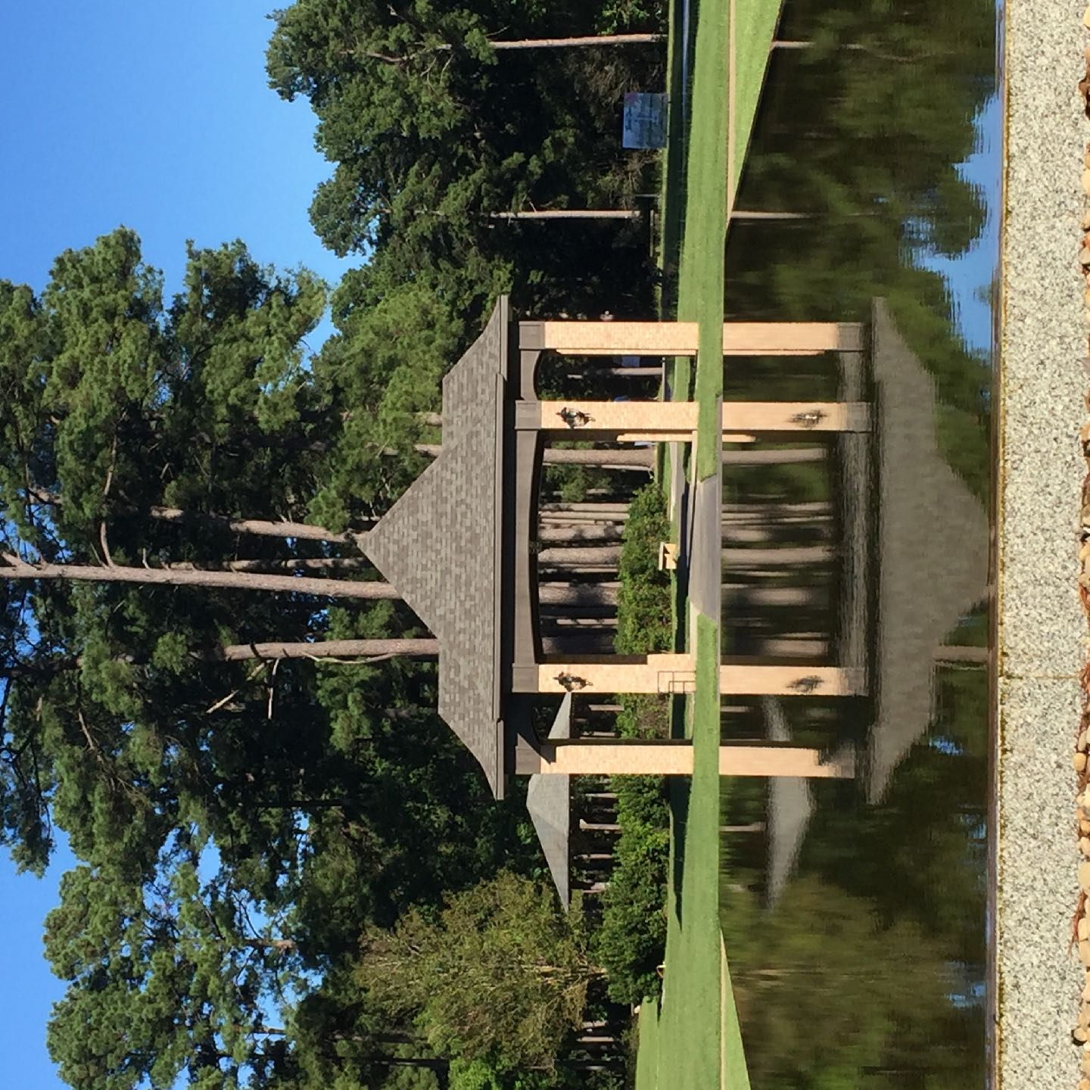
LOOK AT THIS!
The newest addition to the gardens – the beautiful Pat
Shanley – John DelVecchio ROSE GARDEN GATE PAVILION!
Located between the Reflection Pool and the New Garden.

Slide 40
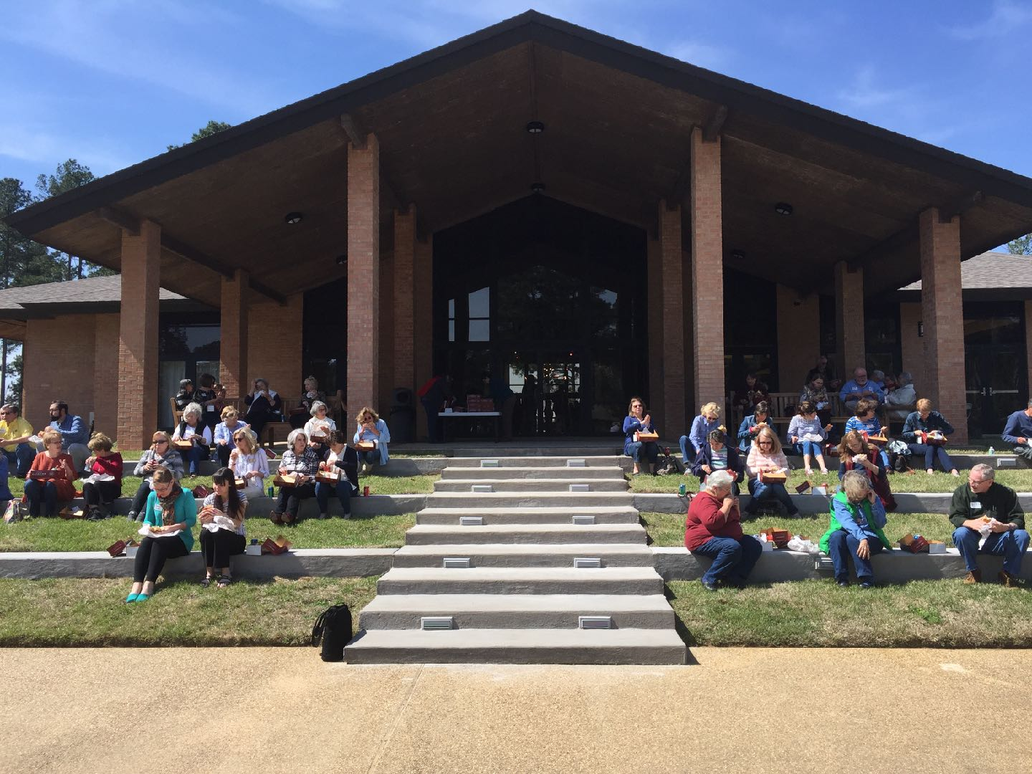
New Wellan Lawn Terrace & Staircase at Klima Education
& Visitor Center, being used and enjoyed as it was meant to be.

Slide 41
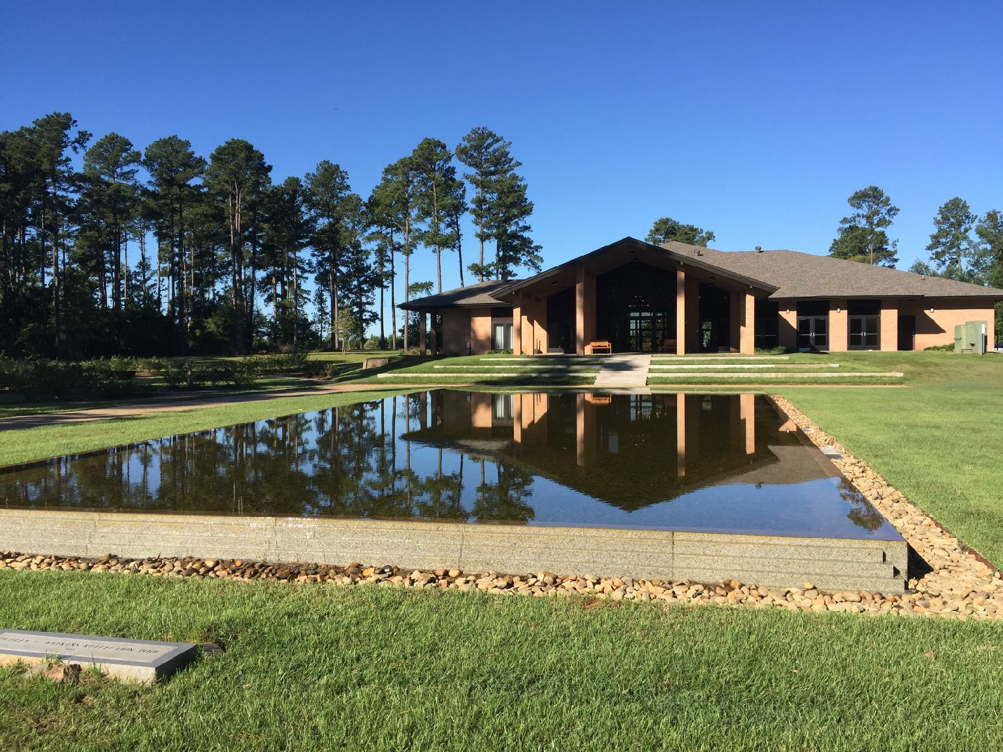
Joseph and Marion Klima’s gift made the Klima Center possible.
Dudley Watkins’ Reflection Pool offers beauty and serenity.

Slide 42
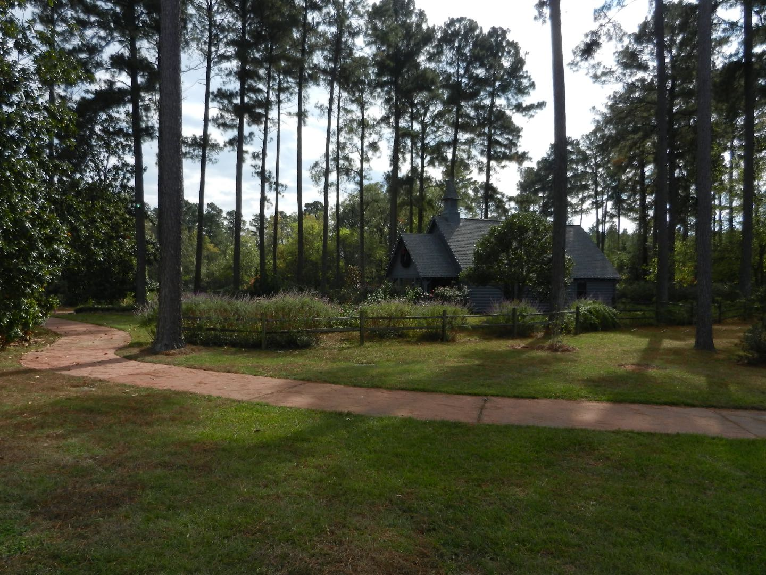
Hardtner Chapel sits in a beautiful setting of pines, magnolias perennials and roses. It is a popular site for weddings and memorial services, and one of the most lovely elements of the gardens.

Slide 43
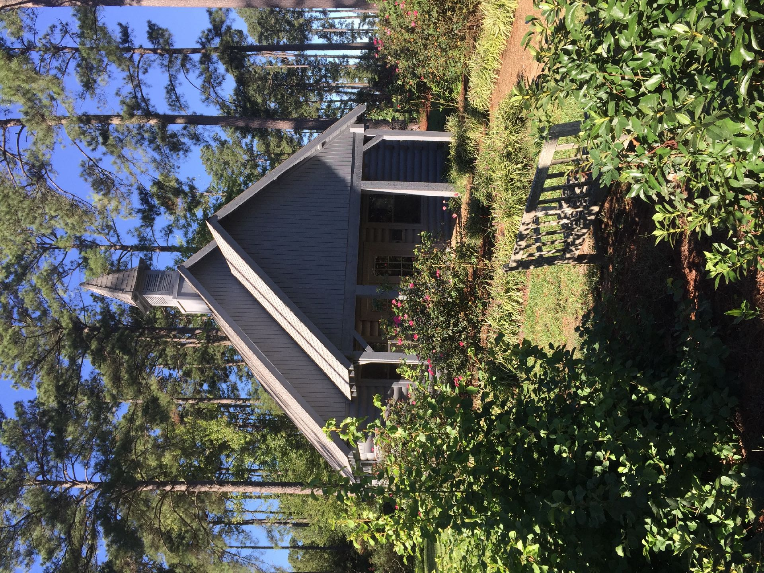
Logs provided the construction materials for the Chapel; it was a duplicate of one remembered from the donor’s childhood.

Slide 44
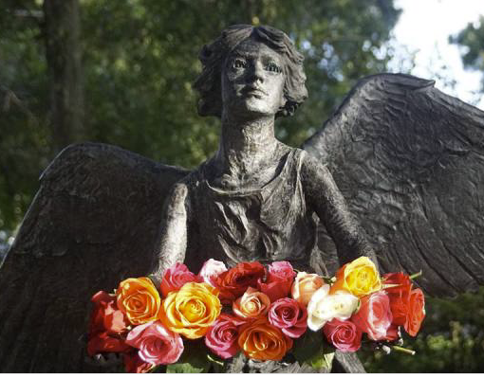
Coming soon . . . .
AN ANGEL for AMERICA’S ROSE GARDEN
There are more than 120 of these Angel sculptures in
garden sites across the U.S. and abroad; the sites are
gathering places for parents and grandparents to remember children who have been lost. In all the sites, candlelight ceremonies are held every year on December 6th to gain solace and comfort in their loss.
The angel is 4’3” tall with a wingspan of 5’2”. Our angel is being cast in bronze at a foundry in Utah, and will be mounted on a pedestal. A dedication is planned for the evening of Friday, September 6. Our first annual Candle Lighting Ceremony will be held at 6 p.m. on Friday, December 6, 2019.
As a result of having the angel in our garden, we will become known to many who would not otherwise know of our gardens. It will give us a wonderful occasion for for the annual event just about the time our Christmas in Roseland “festival” is opening.
Engraved Bricks of Remembrance will be available in the near future.

Slide 45
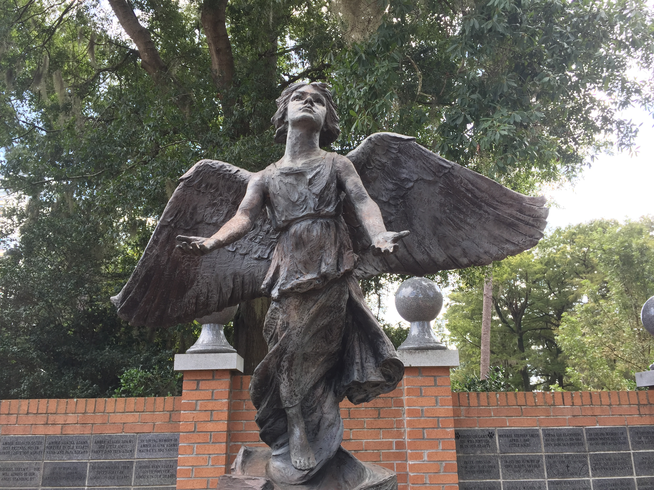
Coming this fall . . . . .

Slide 46
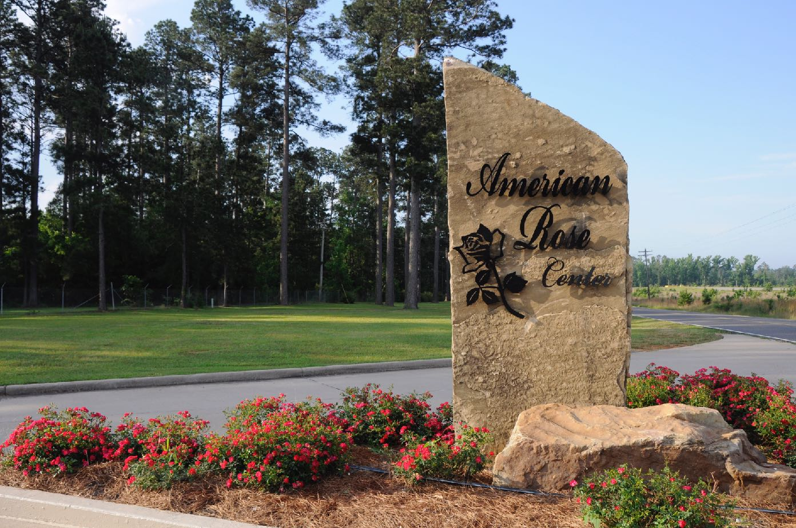
“
NEW ENTRANCE SIGN
Ten feet of natural stone

Slide 47
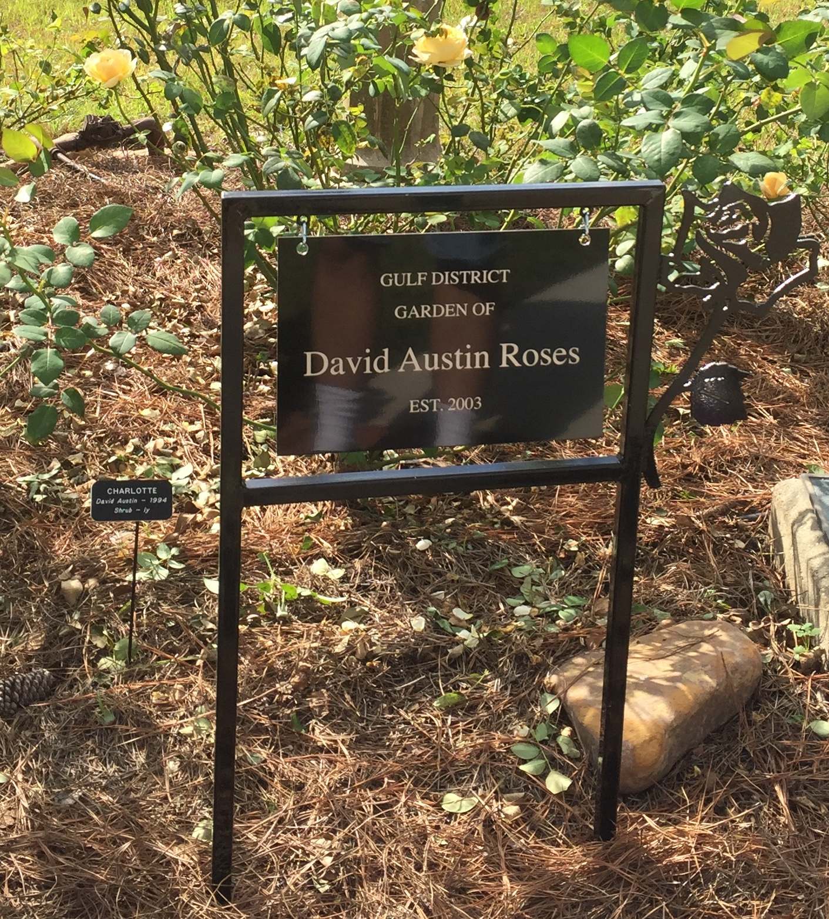
Uniform signage throughout the gardens
NEW UNIFORM SIGNAGE
throughout the gardens.

Slide 48
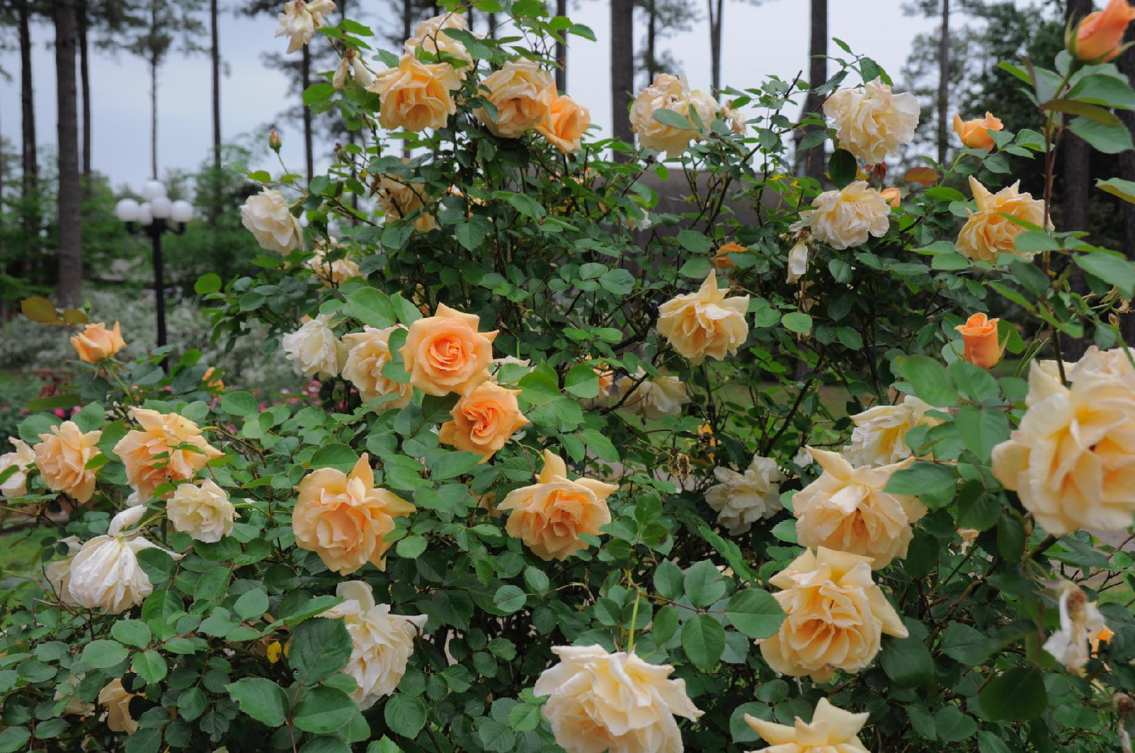
YES, IT’S ALL ABOUT THE ROSES!

Slide 49
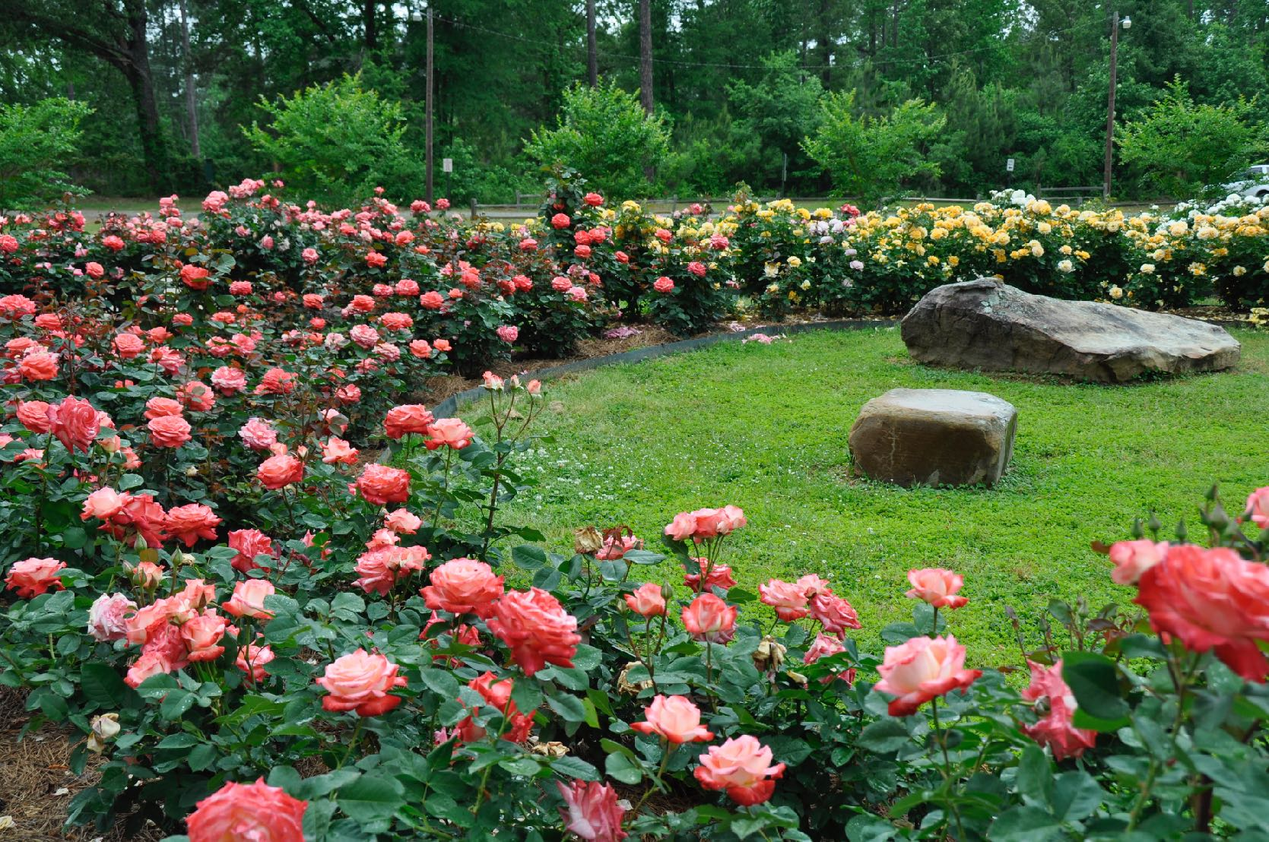
LIKE THE ROSES IN THE
BUCKEYE DISTRICT GARDEN

Slide 50
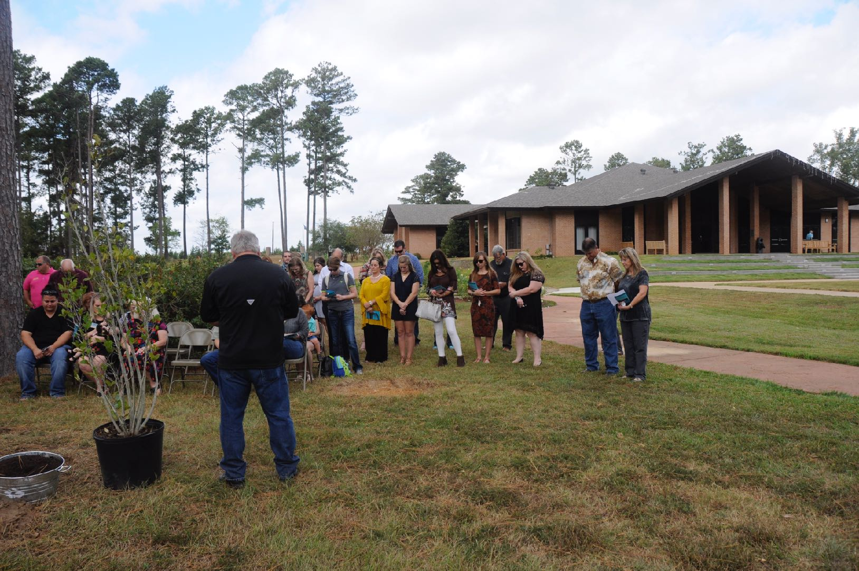
IT’S ALL ABOUT BRINGING PEOPLE TO THE GARDENS
LIKE THIS PLANTING OF A MEMORIAL TREE.

Slide 51
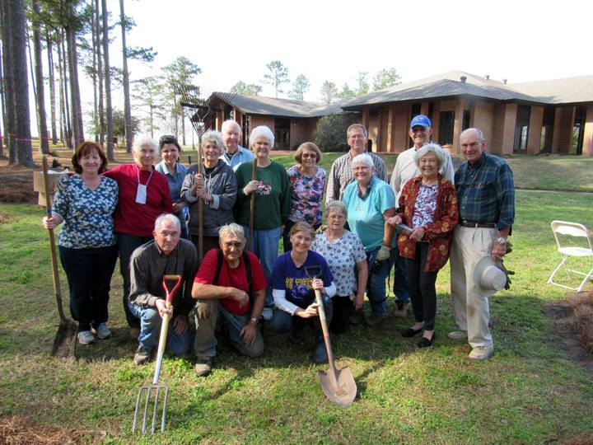
IT’S ALL ABOUT THE VOLUNTEERS WHO HAVE GENEROUSLY – AND PHYSICALLY SUPPORTED THE GARDENS.

Slide 52
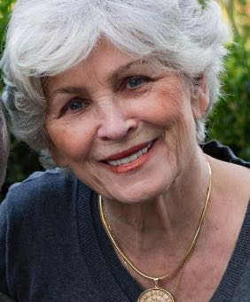
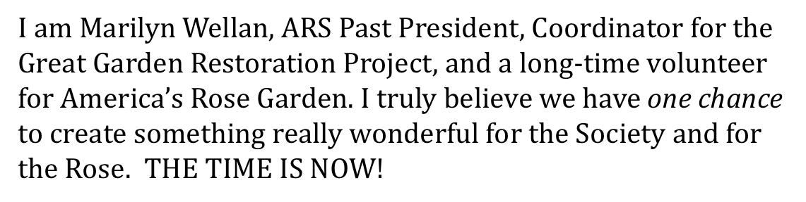
FROM THE COORDINATOR:
“Make no little plans; they have no magic to stir men’s blood and probably themselves will not be realized. Make big plans; aim high and hope and work; remembering that a noble, logical design once recorded will never die, but long after we are gone will be a living thing . . . . . .”
These are the words that inspired the proposal for the creation of a National Rosarium of the American Rose Society in 1935 by ARS President J. Horace McFarland, “Father of the American Rose Society”.
With this presentation, we hope you can see the great need for this restoration that will bring new life to the garden that has been in the making since 1935. We also hope it has given you a sense of ownership for the gardens.

Slide 53
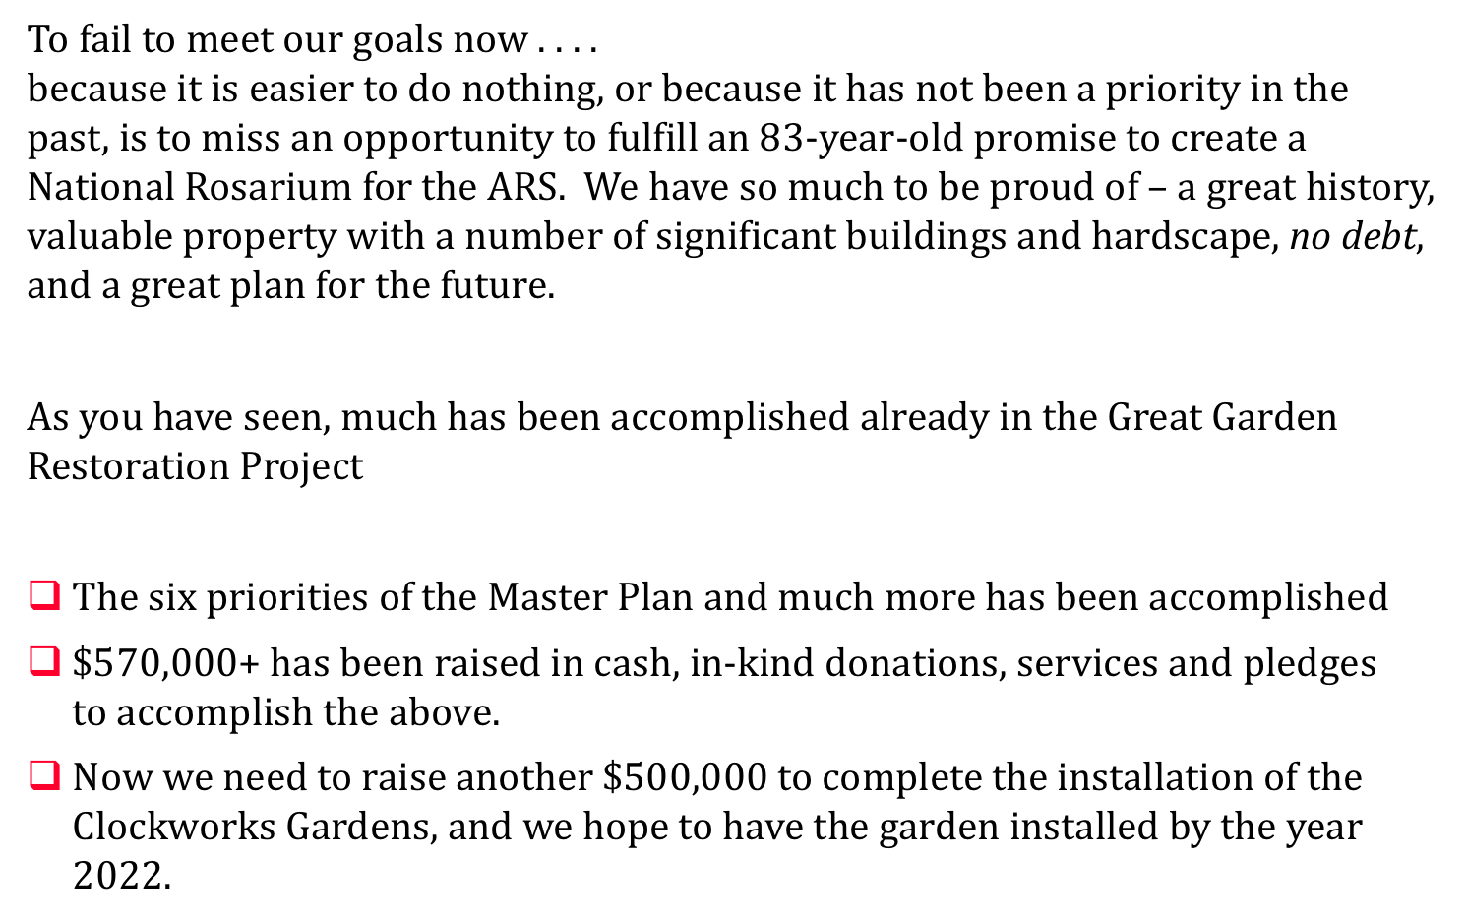

Slide 54
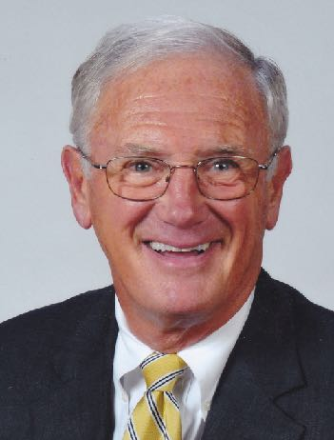
FROM DR. JIM HERING:
President Emeritus Dr. Jim Hering is leading the
effort to help us raise the funds for the Great Garden
Restoration Project. This is Jim’s message to you:
“The Great Garden Restoration will enable the rose
gardens at the American Rose Center to become the
jewel of the American Rose Society which our
predecessors envisioned when we moved to Shreveport in 1974. A “world class” rose garden became even more important when the rose became our national floral emblem in 1986. Together with our District Directors I am looking forward to informing our members in local societies of this grand project and, hopefully, encourage both societies and members to support it financially. Perhaps most significantly, the restored ARC Garden will enhance our education mission by demonstrating “The History of the Rose in America”.
Here is how you can help:

Slide 55
WE WELCOME GIFTS in any amount:
Everyone can be a part of the Great Garden Restoration Project of the American Rose Center. All gifts may be in honor of, or in memory of a loved one.
All gifts will be sincerely appreciated and recognized in American Rose through 2022.
Gifts of $100 or more will be recognized with their name inscribed on a brick to be displayed in the gardens.

Slide 56
THE FIRST CIRCLE:
Be a member of THE FIRST CIRCLE of the garden –
donate $500 or more:
Your gift will be recognized in American Rose through 2022.
Your name will be inscribed under ‘FIRST CIRCLE’ on our permanent
50th Anniversary Wall . . .
THE GREAT AMERICAN ROSE GARDEN RESTORATION Donor Wall.

Slide 57
HUG-A-TREE:
Nurture a tree –
donate $500 or more:
Your name on an attractive label at the base of one of our majestic trees.
Your gift will be recognized in American Rose through 2022.
Your name will be inscribed on our permanent 50th Anniversary Wall . .
THE GREAT AMERICAN ROSE GARDEN RESTORATION Donor Wall.

Slide 58
NAMING OPPORTUNITIES:
Donors opportunities for naming gardens or garden elements –
donate $10,000 or more:
Your gift will be recognized in American Rose through 2022.
Your gift will be honored with special signage in the garden.
Your name will be inscribed on our permanent 50th Anniversary Wall . . .
THE GREAT AMERICAN ROSE GARDEN RESTORATION Donor Wall.

Slide 59
Please contact:
Dr. Jim Hering rosehering@roadrunner.com
or
Jon Corkern Jon@rose.org
or
Marilyn Wellan roseusa@suddenlink.net
to discuss Restoration needs and donor options.

Slide 60
Thank you for your participation
and support for the gardens through the years
and for your support now for the
Great Rose GardenRestoration
2017-2022

