Slide 1
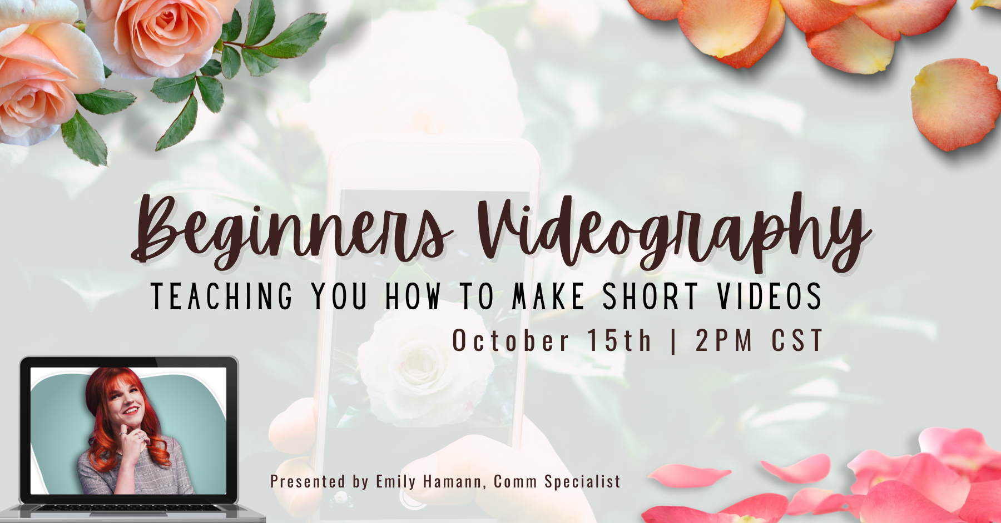

Slide 2

Contents
Introductions
Why do we film?
How do they perform?
The Platforms
The Terminology
The Tools
Before Filming
Shooting the Video
Editing the Video

Slide 3

Welcome & Introductions

Slide 4
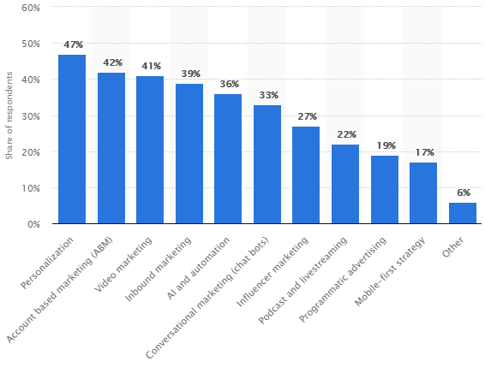
There’s a reason marketers everywhere are delving into videography!
Strategically placed and well-made videos can offer a 95% retention rate.

Slide 5
Why Film Video?
It’s a highly effective media type for what we do!
Images can only convey one thing at a time.
Videos force scrolling users to stop and pay an extra second of attention
60% of consumers and 59% of executives prefer watching ads instead of reading ads
They help us connect deeper.
  12 times more likely to be shared, especially social or educational!
Majority of users (27.2%) spend more than 10 hours watching videos every week.

Slide 6
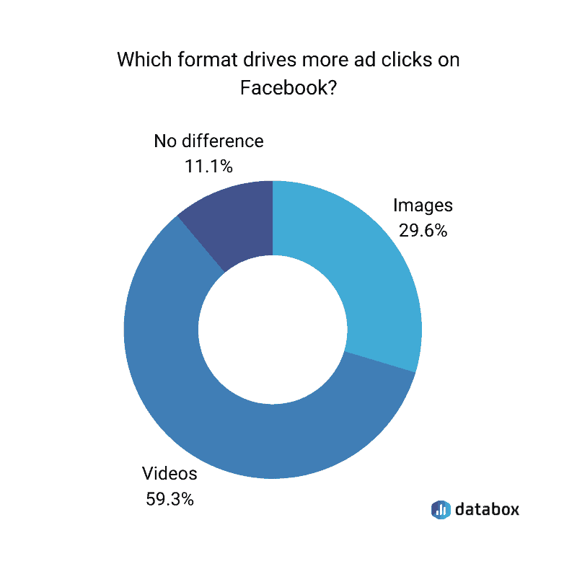
Time consuming? Yes.
Worth it? Also yes!

Slide 7
Why Film Video?
It’s a highly effective media type for what we do!
Images can only convey one thing at a time.
Videos force scrolling users to stop and pay an extra second of attention
60% of consumers and 59% of executives prefer watching ads instead of reading ads
They help us connect deeper.
  12 times more likely to be shared, especially social or educational!
Majority of users (27.2%) spend more than 10 hours watching videos every week.

Slide 8
How does it help, YOU?
Promote Roses Effectively
Share news live or afterwards
  Award ceremonies, rose shows, informational & educational, etc.
Show people what they’re missing!
Help visualize what it’s like to participate!
Rose Societies, Consulting Rosarians, etc.

Slide 9
The Platforms
Where will your video be seen?

Slide 10
Rose.org
Sizing:
  Horizontal ideally.
  Upload via Youtube at 1080p, it will autoconvert wherever embedded.
How well they do:
  23k site sessions monthly
  ~5k users on video pages yearly
    Rose.org viewers, not even including YouTube!
  Usable visibility!
TIP: Host Videos on YouTube
uploading videos directly to the site slows down overall speed.
The American Rose Society Site

Slide 11
YouTube
Sizing
  Horizontal ideally.
  Upload via Youtube at 1080p, it will autoconvert wherever embedded.
    Can get away with 720p for 480p with less quality.
How well they do:
  30.1k Views, Over 3k Hours Viewed
  Some videos reaching 18k-80k views!
  Regularly posting added over 400 subscribers
    Subscribers get notified, increasing viewership.
TIP: You can use the analytics tab to see which videos are doing better than others!

Slide 12
Social Media: 48% More Views
Facebook/Instagram Video Types:
  Feed: a regular video that you share to your profile and it shows up in your followers’ main feeds
    Sizing: Landscape/Square, 1080x1080/1080x608/1080/1350
    Usage: Live on your feed forever. Engage with your existing audience.
  Stories: a short clip that can be viewed on your profile/followers’ main feed. Only last 24 hours.
    Sizing: Portrait, 1080x1920, 15 seconds long, as many as you want in sequence.
    Usage: More casual, behind-the-scenes, bloopers, time sensitive, content. Drive follower engagement.
  Reels: short-form video, direct competition with TikTok. Single/multiple clips edited together. Can add music, text, closed captions, and visual effects to your video in the app.
    Sizing: 1080x1920, up to 90 seconds.
    Usage: Show content to new audience. Attention-grabbing/engaging/educational/authentic over scripted or formal.
  Live: allows users to broadcast live videos to their followers.
    Sizing: Wide range
    Usage: Interactive, viewers can ask questions/comment on the video in real time. Saved to your account, so viewers can watch them again later.

Slide 13
TikTok
Sizes: Varying
Usage:
  Up to 90 seconds long made up of a single clip or multiple clips edited together.
  Add music, on-screen text, closed captions, and visual effects to your video clips in the app.
  Good for educational, entertaining, engaging and beautiful content!
TIP: I really recommend people trying it, it’s not terribly hard to grow a following or make a good video!

Slide 14
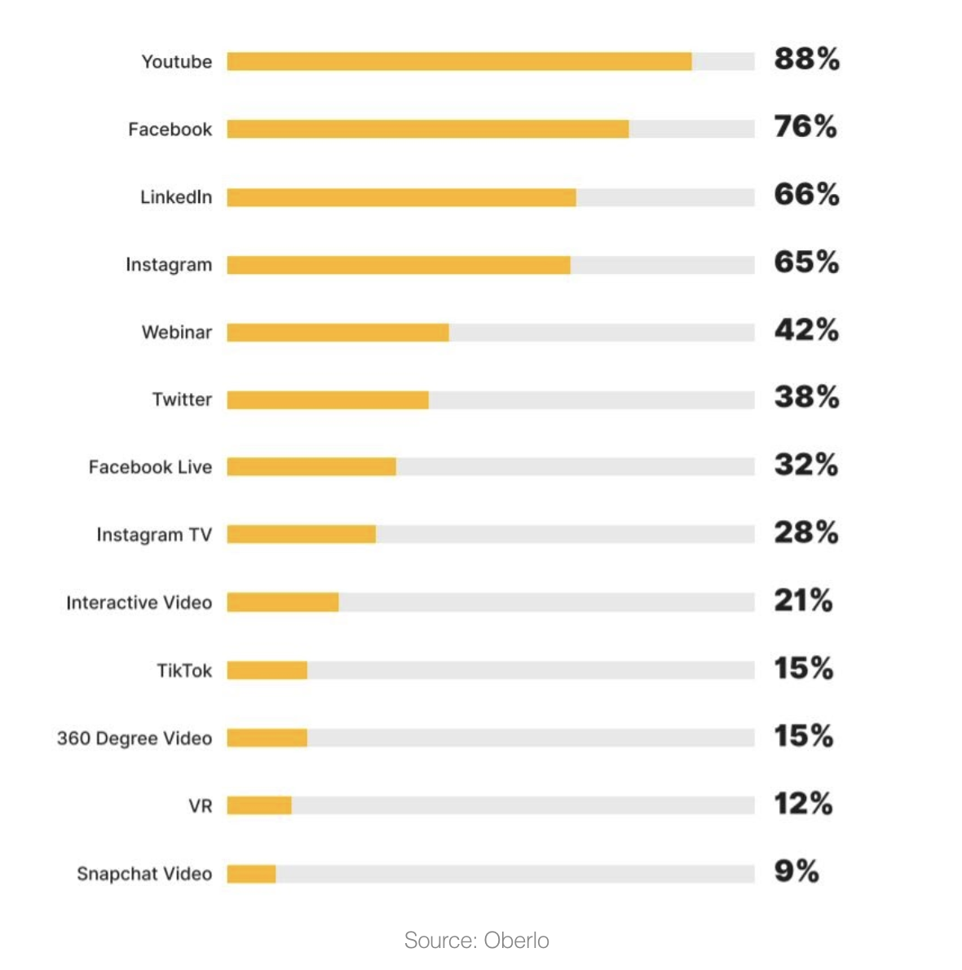
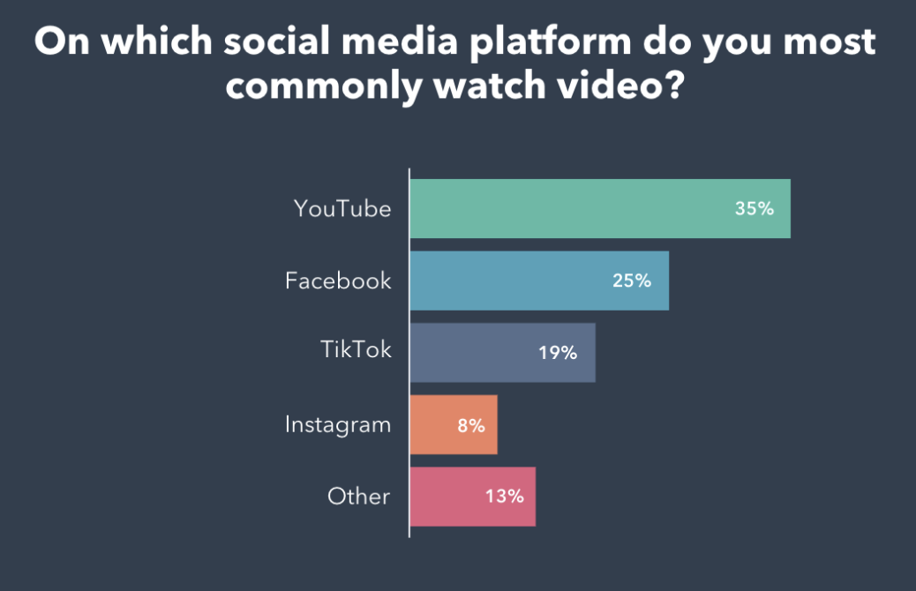
Most popular platform among marketers for sharing videos:
How do they stack up?

Slide 15
The Terminology

Slide 16
The Terminology:
B-roll: Gives you flexibility, supplemental footage that makes a previously incongruent scene smooth.
Provide more details to support the scene
Close ups: Shots that frame the subject tightly.
Cut ins (Insert Shot): Shows the objects the subject is in contact with or manipulating (roses, rose tools)
Medium Shot: Also known as a waist shot, frames the subject's upper body.
Rule of Thirds: Divide shot into 9 equal sectors by two horizontal lines and 2 vertical lines.
  The primary subject positioned where 2 of the 4 points intersect. Draw the eye toward the main points of interest in the shot. We naturally gravitate and dwell towards the top-left anchor point.
Aspect Ratio: Relates how the width and height of your video. Expressed through a ratio.
  Pixel Aspect Ratio (PAR): Pixels are the thousands of tiny squares that make up each image in your video.
    While aspect ratio is between WxH of your video, PAR is the ratio between the WxH of the pixels.

Slide 17
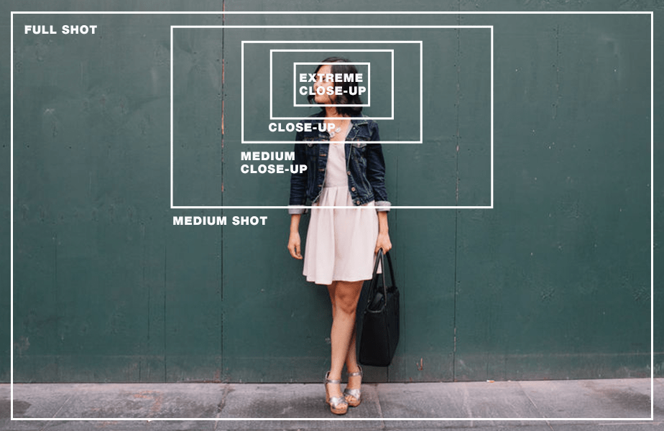

Slide 18
The Terminology:
B-roll: Gives you flexibility, supplemental footage that makes a previously incongruent scene smooth.
Provide more details to support the scene
Close ups: Shots that frame the subject tightly.
Cut ins (Insert Shot): Shows the objects the subject is in contact with or manipulating (roses, rose tools)
Medium Shot: Also known as a waist shot, frames the subject's upper body.
Rule of Thirds: Divide shot into 9 equal sectors by two horizontal lines and 2 vertical lines.
  The primary subject positioned where 2 of the 4 points intersect. Draw the eye toward the main points of interest in the shot. We naturally gravitate and dwell towards the top-left anchor point.
Aspect Ratio: Relates how the width and height of your video. Expressed through a ratio.
  Pixel Aspect Ratio (PAR): Pixels are the thousands of tiny squares that make up each image in your video.
    While aspect ratio is between WxH of your video, PAR is the ratio between the WxH of the pixels.

Slide 19
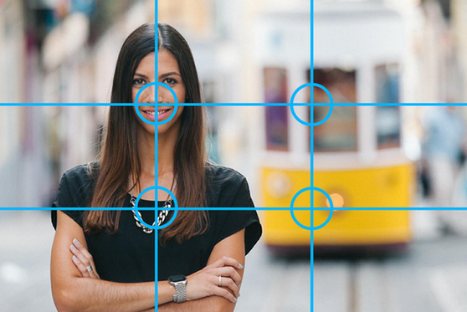
Rule
Of
Thirds:

Slide 20
The Terminology:
B-roll: Gives you flexibility, supplemental footage that makes a previously incongruent scene smooth.
Provide more details to support the scene
Close ups: Shots that frame the subject tightly.
Cut ins (Insert Shot): Shows the objects the subject is in contact with or manipulating (roses, rose tools)
Medium Shot: Also known as a waist shot, frames the subject's upper body.
Rule of Thirds: Divide shot into 9 equal sectors by two horizontal lines and 2 vertical lines.
  The primary subject positioned where 2 of the 4 points intersect. Draw the eye toward the main points of interest in the shot. We naturally gravitate and dwell towards the top-left anchor point.
Aspect Ratio: Relates how the width and height of your video. Expressed through a ratio.
  Pixel Aspect Ratio (PAR): Pixels are the thousands of tiny squares that make up each image in your video.
    While aspect ratio is between WxH of your video, PAR is the ratio between the WxH of the pixels.

Slide 21
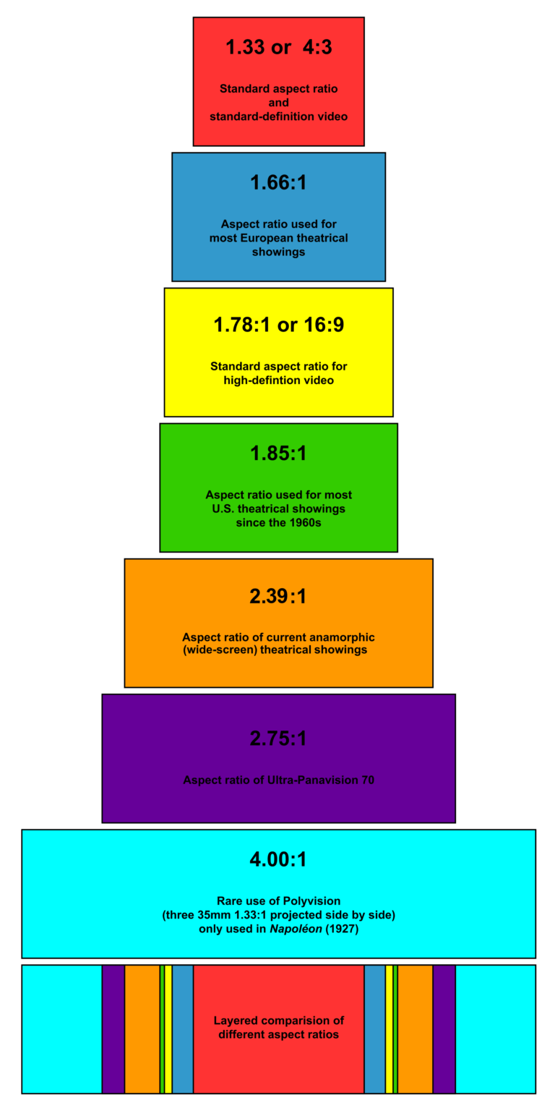
Aspect Ratio Examples:

Slide 22
The Terminology:
Pans & Tilts: Made with camera.
  Pans = fixed horizontal movements.
  Tilts = fixed vertical movements
Resolution: Actual number of horizontal and vertical pixels your video contains.
  Common Examples: (SD) 640×480, (HD) 1280×720, (HD) 1920×1080
Exposure: Amount of time camera sensor is exposed to light. Longer time = more light that & brighter footage.
Lower thirds: Derives from the Rule of Thirds.
  A Lower Third is a type of title used commonly by news broadcasters, YouTubers, vloggers, and interviewers.

Slide 23
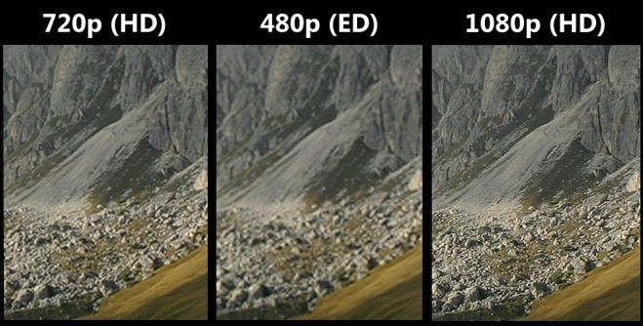
Resolution Examples:

Slide 24
The Terminology:
Pans & Tilts: Made with camera.
  Pans = fixed horizontal movements.
  Tilts = fixed vertical movements
Resolution: Actual number of horizontal and vertical pixels your video contains.
  Common Examples: (SD) 640×480, (HD) 1280×720, (HD) 1920×1080
Exposure: Amount of time camera sensor is exposed to light. Longer time = more light that & brighter footage.
Lower thirds: Derives from the Rule of Thirds.
  A Lower Third is a type of title used commonly by news broadcasters, YouTubers, vloggers, and interviewers.

Slide 25
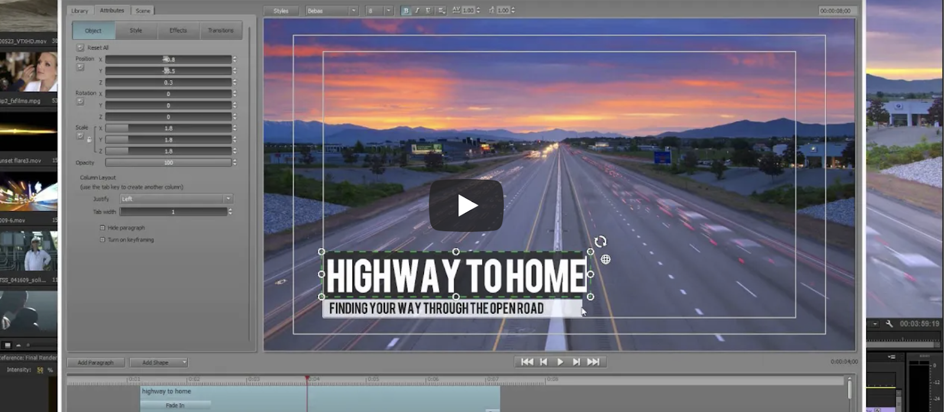
Lower Third Example:

Slide 26
The Tools

Slide 27
The Tools
What they’re good for:
Keeping up with your members
People closer to joining
People wanting to foster great engagement with their members!
BEWARE: Think about making yours private and adding folks when they join. This reduces spam.
Who they’re for:
Someone with a Facebook
Someone who knows the basics of Facebook
Upkeep:
Less upkeep for the manager because everyone can add and share to said group!

Slide 28
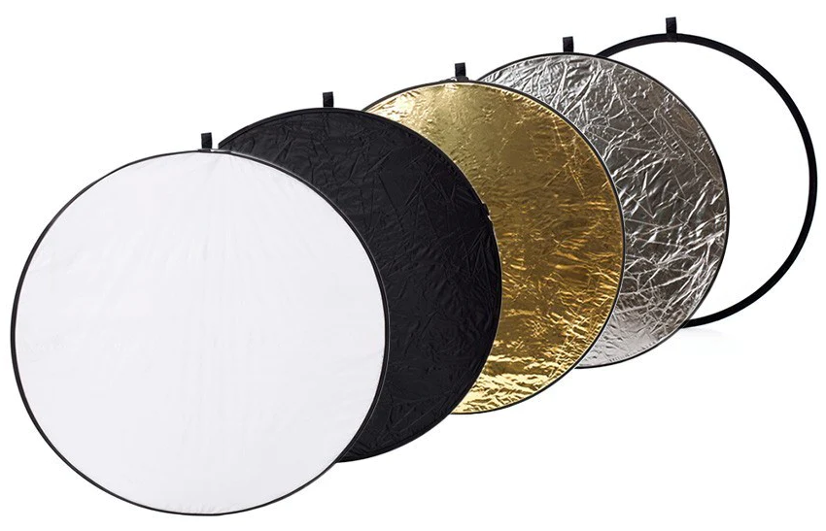
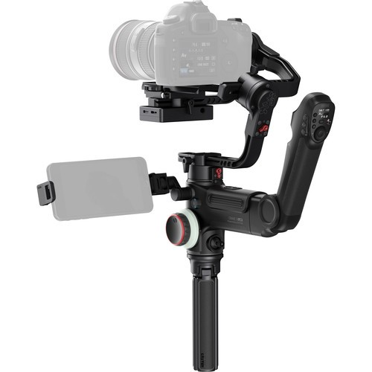
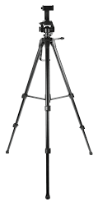
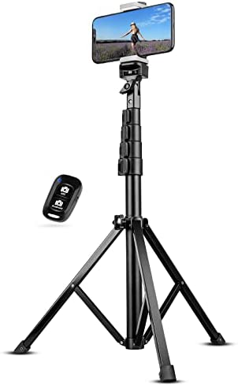
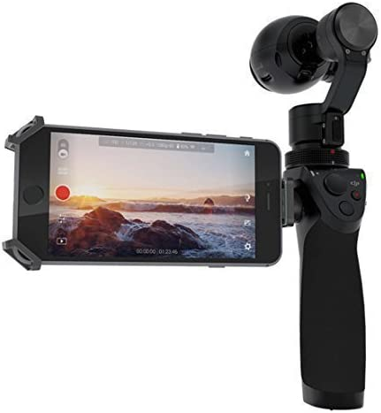
The Tools
Phone Or Tablet
  iPhone, Android, or any up to date phones/tablets work fine!
  Be sure to check the filming size/resolution
    Settings > Camera
    Ex. 4k at 30-60 FPS depending on my needs.
Digital Camera
  Most have an option for video.
Stabilizers:
  Helps do smooth pans, tilts, b-roll, zoom, etc.
    Osmo & Zhiyun sticks/apps
      Multiple options
    Tripod - Simplest form
Lighting: SUPER IMPORTANT
  Natural Shade
  Diffusers & Reflectors

Slide 29
Before Filming
Set yourself up for success!

Slide 30
Best Practices
Gather your Performers/Speakers
  Actors play a role (gardener, neighbor, local rose society member)
  Speakers do that, they speak! Could be announcers, judges, presidents of LRSs
  Models showcase either products, examples, etc., (might show how to use a tool)
Ensure comfort for involved parties: It’s Kind!
  Water for performers/staff
  Dressing spot if needed
  Snacks
  Shade
Save time, be prepared!
  Make a script
  Make a shot list: Desired shots/clips you want.
What you’ll need and need to know.

Slide 31
Best Practices
Get Lighting Right:
  Do a “site-see” to prep for lighting/space needs.
  Go at the planned time of day beforehand.
  Move to shaded spots.
  Play around with backdrops.
Checklist:
  Props: Tools, plants, pointers, etc.?
  Lighting tools: Diffuser/Reflector
  Stabilizer/Tripod
  Chairs
  Podium
  Tape/Gaffer’s Tape
  Extra Batteries/Chargers
  THE CAMERA/Card if needed
  And probably more!
Set the stage.

Slide 32
Shooting the Video

Slide 33
Filming & Composition
Composition is crucial to the finished product.
How a shot is framed and staged, or “composed.”
How your subject – whatever you’re filming – is arranged within the shot.
Split the video into parts if it’s longer
You’ll need multiple takes & you won’t need to start from the beginning.
Keep time markers
  Write down time stamps for what info is happening in each part/edit requests
Get Creative!
Get b-roll, Close ups, Cut-in footage (zoom in on a rose in question, tools, etc.)
TIP: Suggested horizontal orientation for phone videos, no more than 2-5 min. Stories/TikTok portrait orientation

Slide 34
Editing Videos
Or as much on this as I can fit into this webinar.

Slide 35
Editing Videos
Web Softwares:
  iMovie
  Included Phone/Tablet editing app.
  Canva
Desktop Softwares
  Adobe Premiere Pro: for main editing
  After Effects: effects and editing
  & many more!
Free ones will work!
Play around with a few.
Try YouTube Tutorials for in-action assistance.
TIP: include captions/check the auto-generated ones. The internet is for everyone, let’s make it accessible!
Can be time consuming, fair warning.

Slide 36
Editing Videos
Assemble Rough Cut
  Before working out any timing issues.
  Label clips in order.
    Get your clips roughly into place.
Don’t Assume You Can Fix Everything in Post-Production
  Editing packages such as Premiere Pro and Final Cut Pro great but not magic!
Can be time consuming, fair warning.

Slide 37
Let’s Get Growing!
Get out there, start filming, and show the world what it’s like to be a rosarian.

Slide 38

So how can I help?
Between Google, the American Rose Society, and myself, if you want to reach new members with education and involvement using videos, we can help!

