Slide 1
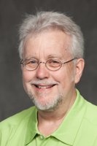
Chemical Safety
Don Myers, PhD
Consulting Rosarian
Master Rosarian
May 2020

Slide 4
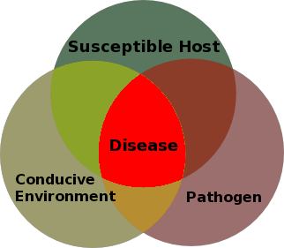

Slide 8
How do you describe a pesticide?

Slide 9


Mode of Action

Slide 10
1 Danger: Poison
Highly toxic, less than 1 tsp
No signal word

Slide 11

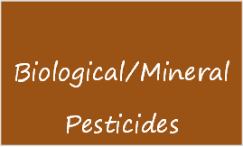


The Choice is Yours
Make an informed recommendation
Consider all possible solutions before making a recommendation
Beware of anecdotal recommendations without backing
Consult and abide by the label—the LAW

Slide 12
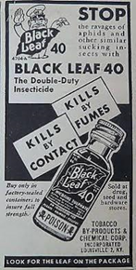

Slide 13
Lethal Dose--LD 50
Amount of chemical/pesticide which kills 50% of the test subjects (eg. insect targets)
The lower the LD 50 the more toxic the chemical. The higher the LD 50, the lower the toxicity.

Slide 14
Ros-E-IQ (Environmental Impact Quotient)
A number from 10-100 (Dr. Gillman’s research)
Summarizes the toxicity of chemical to natural enemies, wildlife, humans, exposure, aquatic and terrestrial effects
The higher the number the greater the impact (<25 desirable)
Objective: Evaluate field use of pesticides on roses and those in individual gardens
www.pacificrosesociety.org

Slide 15
Field Use Rating of Rose Care Products (R-E-IQ)
Common Name | Trade Name | EIQ
Bacillus | Serenade Biofungicide | 7.6
Potassium bicarbonate | GreenCure | 8
Fosetyl AL | Aliette | 11.3
mancozeb | Manzate M45 | 14.6
captan | Captan | 15.8
thiophanate methyl | Clearys | 22.4
propiconazole | Banner MAX/Honor Guard | 27.5
myclobutanil | Immunox | 29.4
trifloxystrobin | Compass | 30.9
chlorothalonil | Daconil | 40.1
tebuconazole | Bayer Disease Control | 40.3
sulfur | Safer Garden Fungicide | 45.5
copper | Bordeaux | 67.7

Slide 16


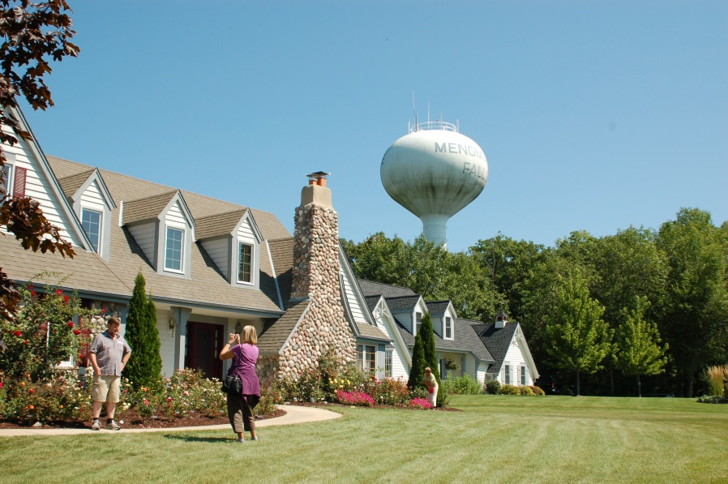

Safety First!!

Slide 17

Review yearly
Review when buying a new container
Review at rose society meetings/CR meetings

Slide 18
What’s on a label?
Active ingredient information (%)
Signal Word—Caution e.g.
First Aid Statement
Environmental hazards
Description of where to use
Use directions
Mixing instructions
Storage and disposal
Some language is mandated by EPA. Other language is proposed
by the manufacturer and negotiated with EPA.

Slide 19
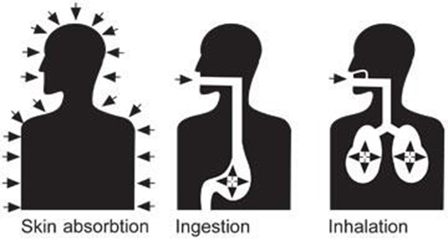
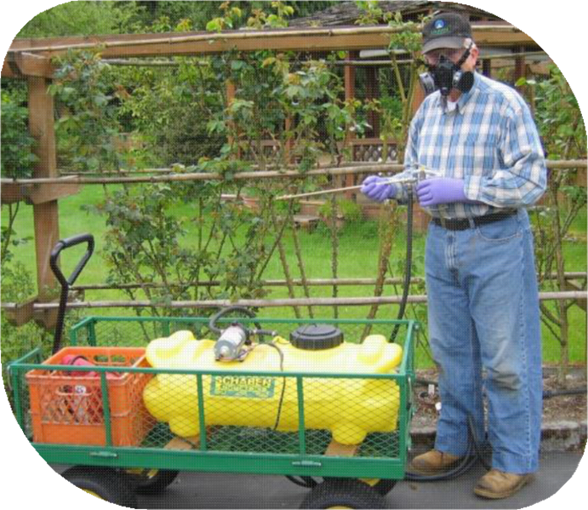
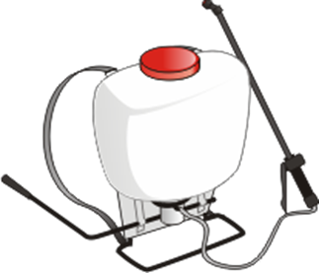


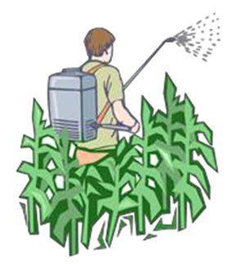

Slide 20


Slide 21

General Reminders
Identify the problem and use proper solution
Avoid pesticide cocktails
Spray only necessary pesticides
Buy only what is needed for the year
Designate specific herbicide sprayers
Never store pesticides in another container
Water well before spraying to reduce
plant stress
Respect concerns of your neighbors

Slide 22
Application Reminders
Protect yourself, children, pets, and neighbors
Be careful spraying on windy, hot, or rainy days
Spray to get good coverage
Wash exposed skin immediately after spraying
Dispose of unused pesticides and containers safely
Clean and store sprayer
Store pesticides safely and away from children

Slide 23
The following is a CR training exercise (scenarios) and is not based on actual situations or people.

Slide 24
Background
It’s 2020…Don Nozall is president of the Raleigh Rose Society. Don is a fixture in the Carolina District and has been growing roses for over 50 years. He has kept his local rose society together by being president the last 10 years. He gives many of the programs himself and considers himself the definitive rose expert in the society by dispensing advice on all subjects to all who will listen.

Slide 25
Background continued
Recently, a new CR, Brenda Nicely has begun to question some of the recommendations made by Don. She has tried to discuss her concerns with him but he told her,
“ I’ve been growing roses since before you were born and don’t need a CR to tell me how to grow roses. In fact, that CR program is all screwed up anyway. I don’t need to be recertified. It’s a load of manure. I wrote the book!”

Slide 26
Background continued
Brenda was understandably nervous about dealing directly with Don and decided to write a letter to the Board of the Raleigh Rose Society to document her concerns. You are a fellow CR and the Board has asked you to help her. The following summarizes her six major concerns.
Additional concerns?
How would you address him?

Slide 27
Concern #1
In a recent presentation Don Nozall said, “If it flies, it dies. We exhibitors need to spray for bugs every week to keep the judges happy. Controlling insects is about putting them on their backs. I heard about a new chemical used on turf called “Eliminate” available from a local ag supplier and got a sample from my friend to try on my roses. It is great stuff! I’ll get a supply for the rose society.”
Brenda suggested that you need to be careful about using insecticides and practice IPM. Don said those organic things just don’t work.
How would you address Don?

Slide 28
Concern #2
Don Nozall bought a supply of Bayer’s miticide, Forbid, from an on-line supplier. It is registered on roses and is very active, killing both adult and egg stages according to the company. He paid nearly $300 for that bottle and decided to subdivide the bottle into 10 samples for members of his rose society. When Brenda suggested that he shouldn’t do this, he told her,
“It is perfectly OK provided that it is (1) placed in a leak proof, sealed neoprene plastic bottle approved for hazardous chemicals, that you (2) provide a current label of the product to the user, and that you (3) not charge anything for the subdivided pesticide. I am donating the chemical to the rose society out of the goodness of my heart.”
How would you handle this issue?

Slide 29
Concern #3
Don Nozall gave a presentation on pesticide safety at a recent meeting and made the following comments.
“I don’t need a spacesuit to spray pesticides. It’s just common sense. Don’t get it on you and use the wind to keep the mist away from you. And there a lot of other things that are more important causes of cancer than exposure to pesticides. After spraying I keep the mixed product in my sprayer for next week and mix it with my fresh stuff. Bayer told me that most products last 5 years anyway. I don’t like disposing of unused pesticides in my yard. That’s why I never dump the unused spray material. It is important to protect the environment.”
What does pesticide safety mean to you?

Slide 30
Concern #4
Don Nozall routinely gives a 15 minute talk, called “Don’s Chat”, at rose society meetings for new rose growers. He made the following comments on disease, insect, and mite control.
“I know some of you don’t like spraying. But there are so many chemicals to choose from that are safe. Keep it simple. That is the motto of the CR program after all. Mix your fungicide, insecticide, miticide, pH adjuster, adjuvant, and a pinch of Response together. Spray every week and you will have no problems. If you have to think too much, you can make mistakes. Anyone can grow roses and we want to provide our new rose society members with simple, straight forward recommendations.”
What kind of simple, straight forward recommendations would you make?

Slide 31
Concern #5
Don Nozall had these comments about his granny at the annual holiday party.
“My Granny had beautiful roses and never sprayed them…period! Blackspot is the most important disease of roses in our district and Granny new it. She was a great house keeper and every week she would go out and pick off the black spot leaves. In this way the disease is kept from spreading by reducing the number of spores, and you don’t poison the environment with pesticides. Your rose plants look better too. I like this approach for new rosarians. If you’re not an exhibitor, you can also grow one of the “Knock Out” roses or many of the Kordes roses that don’t require spraying.”
How effective is granny’s idea of sanitation? Which roses would you recommend to the general gardener who wants to grow a few roses in their perennial garden?

Slide 32
Concern #6
Don Nozall gave a presentation on rotating chemicals at the district meeting. His comments included the following.
“Rotating chemicals is important for disease control, particularly blackspot. In a good rotation, the fungus sees a different mode of action over time and this reduces the chance for the fungus to mutate and become resistant. That is why I use the following rotation when it’s hot and humid in NC in my weekly rose pesticide cocktail. Week 1-Banner, Week 2-Immunox, Week 3-Rubigan, Week 4-Bayer Advanced Disease Control for Roses. If necessary I repeat the rotation. I know what I’m talking about.”
Does he??

Slide 33
Conclusions
Sustainable rose growing is linked to chemical safety.
CRs should always promote safe use of chemicals.
Safe use of chemicals protects the user and the environment.
Rose E-IQ is a useful tool for CRs to choose the lowest effective chemical/pesticide for use I their garden in their district.
Designation of a chemical as natural or organic does not mean they are safer than synthetic pesticides.

Slide 34
Questions or Comments
Don Myers rokirose@nc.rr.com
919 761-1707

