Slide 1
GoToMeeting Quick Guide

Slide 2
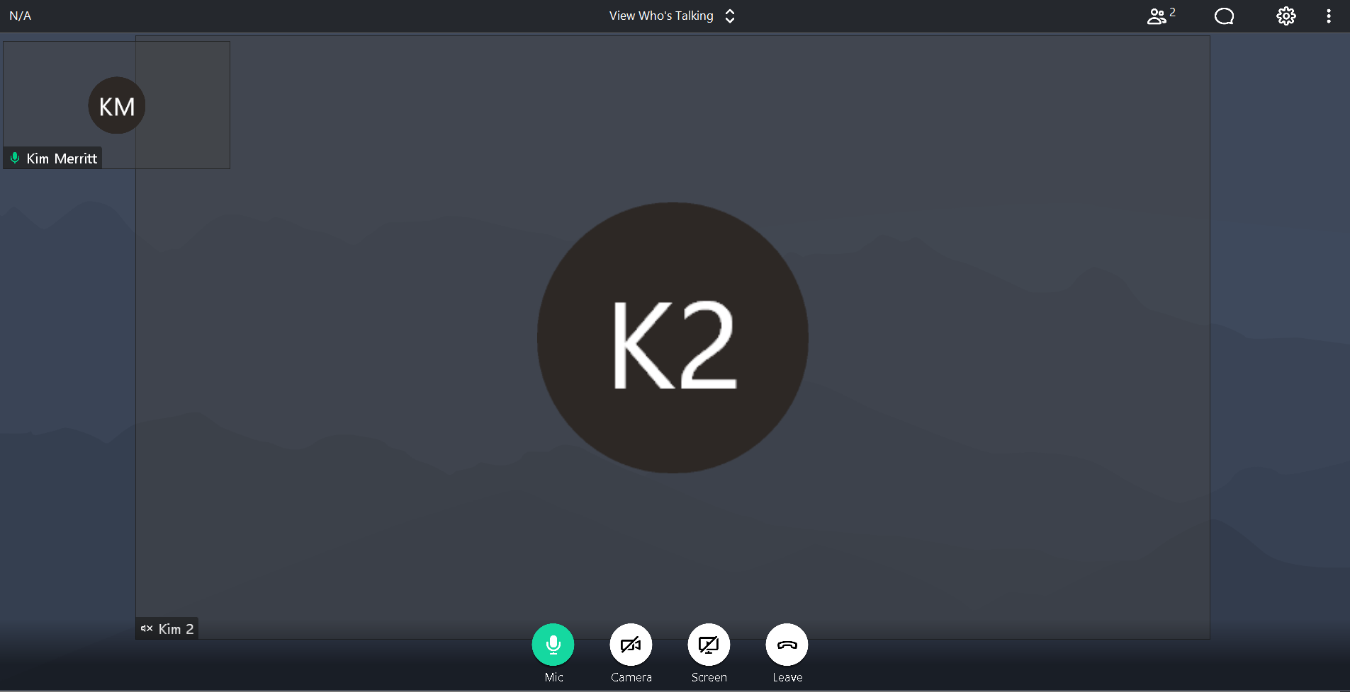
Attendees
Chat
Settings
Mute/Unmute
Webcam
Screen Share
Exit Meeting

Slide 3
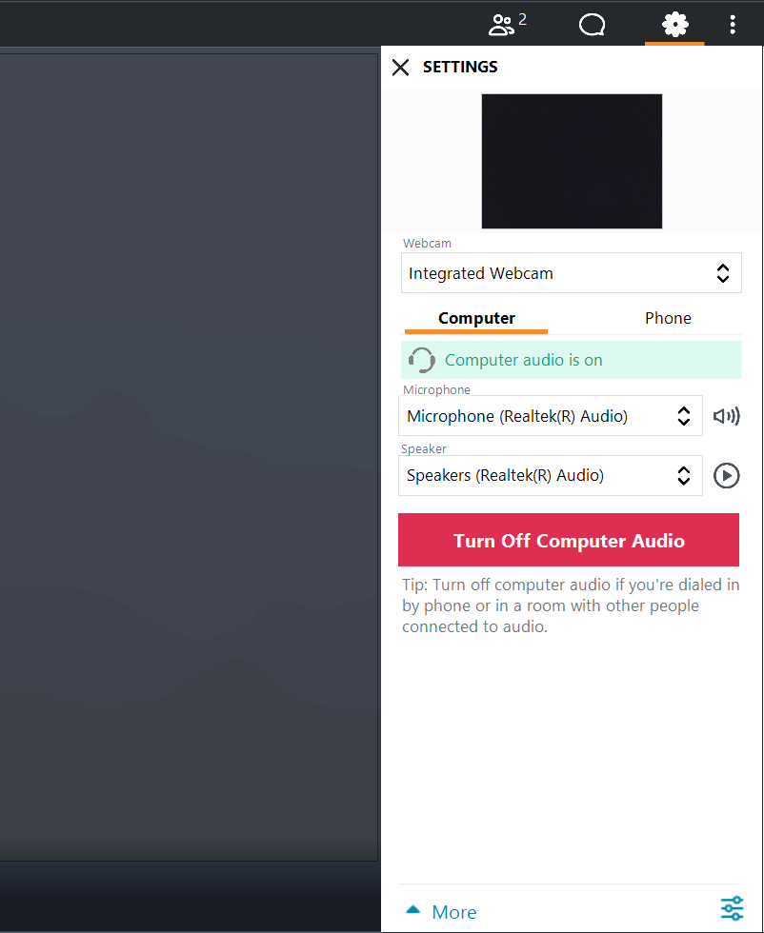
SETTINGS
On the settings tab you can select computer audio or phone to listen to the meeting. If you select computer, make sure your computer speakers are turned on.
If you dialed in, please make sure to turn off your computer audio to avoid an echo.
You can also select to turn on your webcam.

Slide 4
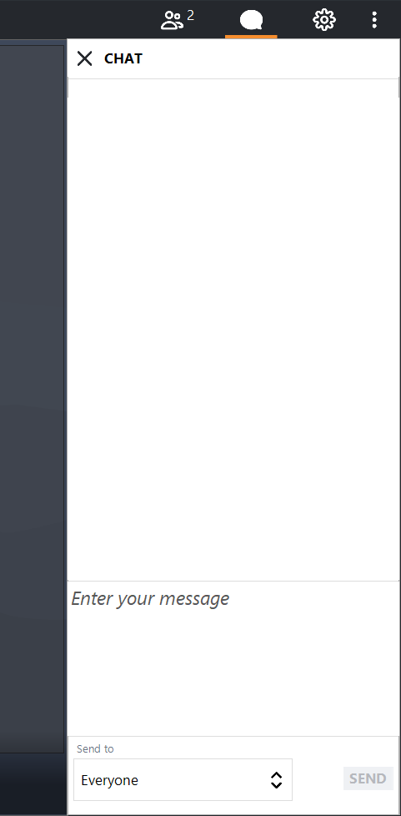
Chat
If you have a question or would like to make a written comment during the meeting, you can use the chat function. At the top right-hand corner of your screen, click on the comment bubble. The chat box will open.
Type your message where it says, “Enter your message” then click “Send”.
Please note the chat feature is set to broadcast your message to everyone in the meeting. If you would like to send a private message, select who you would like to send the message to in the “Send to” box.

Slide 5
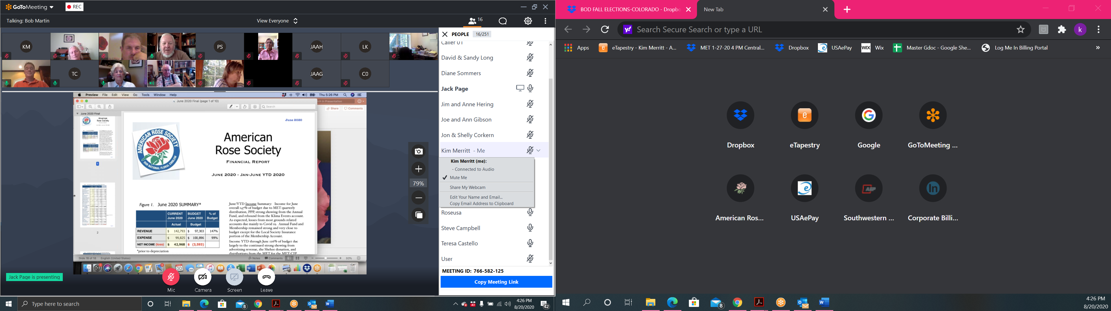
ATTENDEES
In the attendee pod, you can see all the attendees on the call. If you click on the dropdown arrow next to your name, you will have the option to mute/unmute yourself, share your webcam and edit your name.

Slide 6
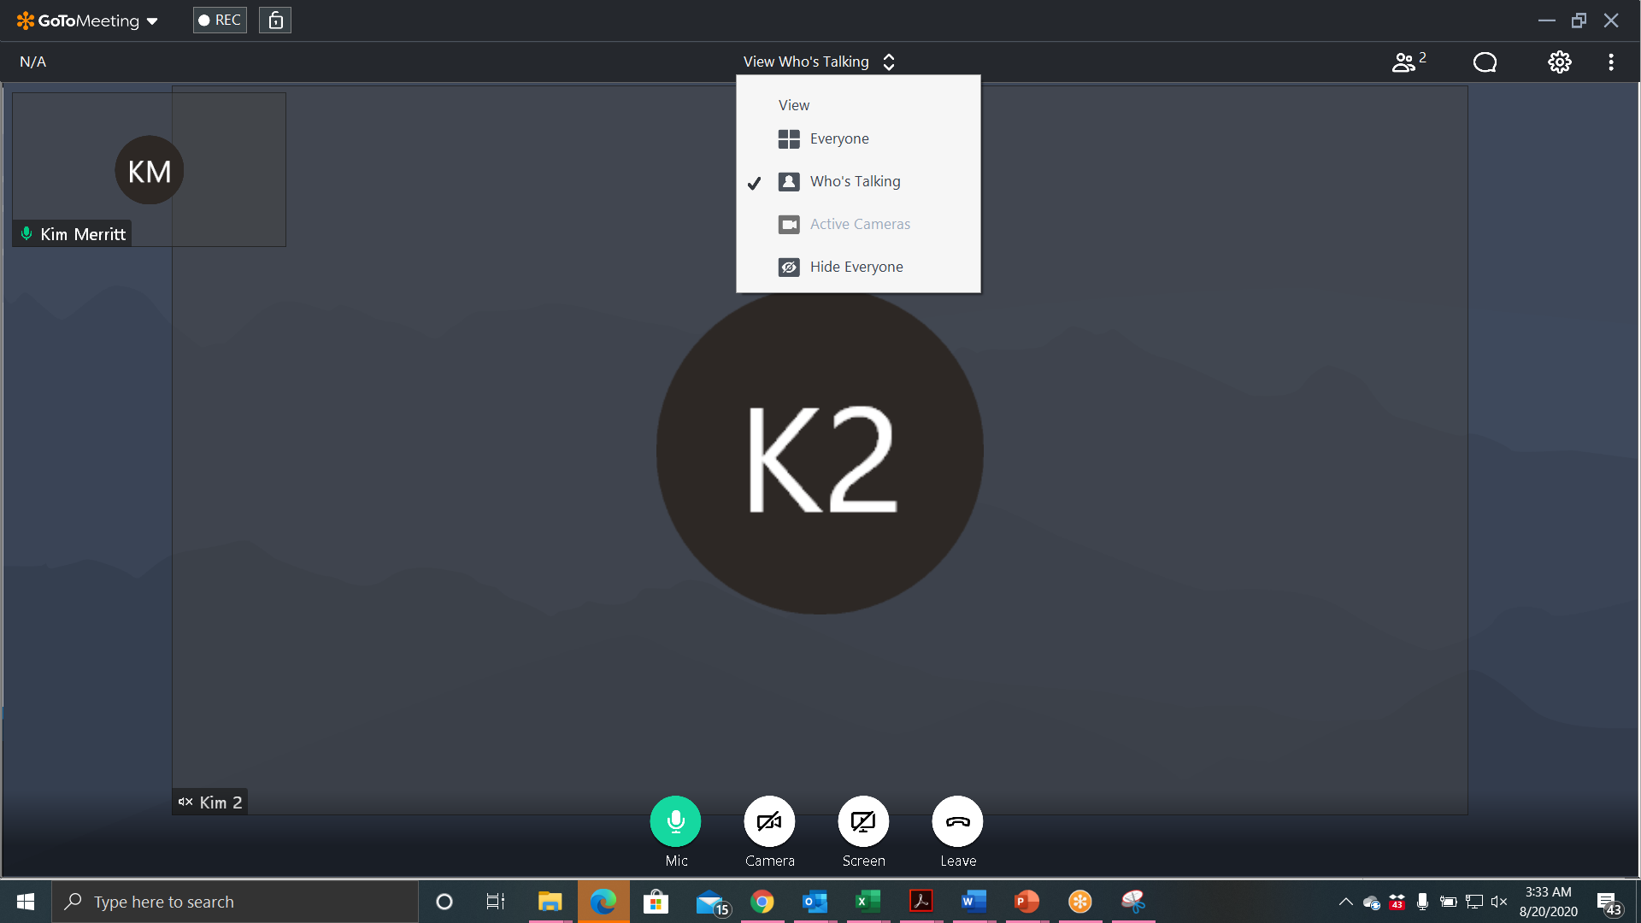
At the top center of your screen, you can select how you would like to view the meeting.
Select everyone, to view all in the meeting.
Who’s talking, to only view the person who is actively talking
Active cameras, to see only those on webcam.
Hide everyone, if you do not want to view any webcams.

Slide 7
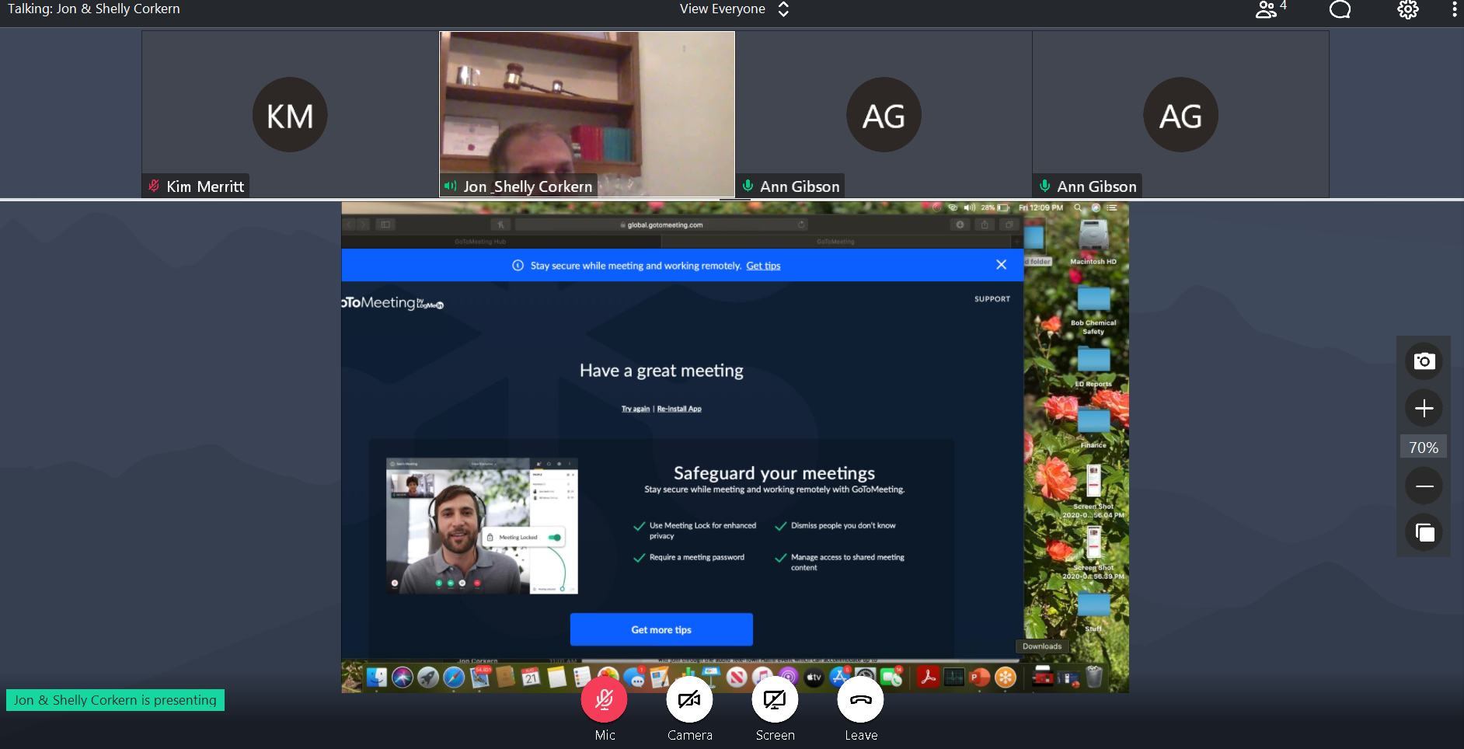
If you would like to zoom in and out of your screen, you should see the option to adjust on the right side of your screen

